Slide 1
RtI:B Booster Training
12/16/2015
Comprehensive Implementation Planning
Please complete your Pre Survey at:
https://www.surveymonkey.com/r/JLCN5KY
Notes:
This Brainshark is intended to help Administrators determine when CHAMPs is being implemented with fidelity in the classroom. Administrators need to understand the subtle and overt aspects of actually implementing CHAMPs that make the difference between a high implementing classroom, resulting in positive student outcomes and a low or non-implementing classroom.

Slide 2
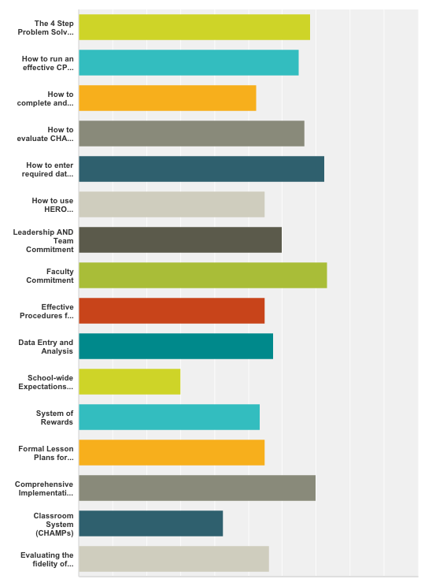
Also see Brainshark Series at
browardprevention.org
Also see BASIS help panel for further
Brainsharks
Also see webinar at
browardprevention.org
Booster Training #1

Slide 3
RtI:B Implementation
10 Critical Elements
1 Team
1 Action Plan
Easy!... Right?
Notes:
the idea of Rti is simple, however, schools are discovering that effective implementation of rti is far from simple

Slide 4

Comprehensive Implementation Blueprint
1. Needs assessment
3 Day
Tier 1
RtI:B Training
2. Organizational Priorities
3. Readiness Checklist
Resource: SAPSI (Self Assessment of Problem Solving Implementation)
Notes:
to determine the degree of need for RTI in your school. (See the Self-Assessment of Problem Solving Implementation for one such tool.) A needs analysis allows the leadership team to articulate the motivation for implementing RTI. In schools where students’ scores are low and have been stagnant or declining for a while, making a case for this innovation is not difficult. Where scores are generally higher, one important step is to analyze the subgroups of students and, once the data are disaggregated, determine if there are groups that are lower performing. If that is the case, then the motivation for RTI can be clearly stated. Even if the district or state is requiring schools to implement RTI, it is still best to articulate why students in your school will benefit from this.
2. For RTI implementation to be successful, it must be a high priority within the school. Sometimes it’s a matter of showing how RTI can become a process that is aligned with and useful in reaching school, admin or district goals.
the principals each had a way of articulating their motivation to change former practices. These principals talked about why practices needed to be different. Their comments were noticeably passionate, specific, and related to their school’s student population.
3. It’s helpful to anticipate the degree of culture change represented by RTI; the team can contemplate the degree of staff acceptance or resistance they expect to see.

Slide 5
Comprehensive Implementation Blueprint
80% agreement =  successful Implementation
4. Consensus building:
Staff presentations & discussions
Need & awareness training
Developing consensus
Surveys
6 months
to 1 year
Resource: Perception and Beliefs Survey
Faculty Commitment Webinar recording:
Notes:
4. Getting buy-in is a process that can be planned—it doesn’t just happen. It starts with a discussion among the RTI team about who needs to be on board for success. identify key influencers who may be negative and place them on a carefully selected committee to try to bring them around from the beginning.
an agreement to support implementation (even by individuals who may not agree with the process but agree to support it.
Staff beliefs are important considerations when seeking consensus from a group.
No child should be left behind.
It is okay to provide differential service across students.
“Academic engaged time” must be considered first. Student performance is influenced most by the quality of the interventions we deliver and how well we deliver them—not by pre-conceived notions about child characteristics.
Decisions are best made with data.
Expectations for student performance should be dependent on a student’s response to an intervention, not on the basis of a score that predicts what they are capable of doing.

Slide 6
Comprehensive Implementation Blueprint
5. RtI:B team building:
Collaborative relationships
Specific roles & responsibilities
Frequent & dedicated meetings
4 step PSP training
Assess own need for further PD
Support interventions
6 months
to 1 year
Resources: Teaming Webinar Recording:
“Effective CPST Meeting” at browardprevention.org
Notes:
4. Getting buy-in is a process that can be planned—it doesn’t just happen. It starts with a discussion among the RTI team about who needs to be on board for success. identify key influencers who may be negative and place them on a carefully selected committee to try to bring them around from the beginning.
an agreement to support implementation (even by individuals who may not agree with the process but agree to support it.
Staff beliefs are important considerations when seeking consensus from a group.
No child should be left behind.
It is okay to provide differential service across students.
“Academic engaged time” must be considered first. Student performance is influenced most by the quality of the interventions we deliver and how well we deliver them—not by pre-conceived notions about child characteristics.
Decisions are best made with data.
Expectations for student performance should be dependent on a student’s response to an intervention, not on the basis of a score that predicts what they are capable of doing.

Slide 7
Comprehensive Implementation Blueprint
Do you have...
6. Develop resources:
Classroom lesson plans (expectations/rules)
Discipline definitions
Data analysis: BASIS 3.0
Interventionist training?
Behavior curriculum: tier 1,
Behavior interventions: tier 2, 3
Funding for incentives
6 months
to 1 year
Resource: Self Assessment of Problem Solving
Behavior Analysis in BASIS Brainshark (TBA)
Behavior Interventions Brainshark
Notes:
an agreement to support implementation (even by individuals who may not agree with the process but agree to support it.
Staff beliefs are important considerations when seeking consensus from a group.
No child should be left behind.
It is okay to provide differential service across students.
“Academic engaged time” must be considered first. Student performance is influenced most by the quality of the interventions we deliver and how well we deliver them—not by pre-conceived notions about child characteristics.
Decisions are best made with data.
Expectations for student performance should be dependent on a student’s response to an intervention, not on the basis of a score that predicts what they are capable of doing.

Slide 8
Comprehensive Implementation Blueprint
Scheduling
matters!
7. Delivery model:
Teaching staff the lesson plans
Schedule students lesson plans
Booster sessions for staff & students
Orientation for incoming staff & students
Planning for community involvement
1 year+
Resource: Implementation Webinar: 4/8/16
Notes:
7. Who Teaches Intervention Groups? Where Do Intervention Groups Meet? When Do Intervention Groups Meet?
schools that add an implementation block to their master schedule make earlier progress in their implementation than those that don’t.

Slide 9
Comprehensive Implementation Blueprint
8. Ongoing PD and coaching:
4 step PSP
School-wide champs
School-wide positive behavior plan
Administering assessments
Interpreting data
Grouping students
Explicit and systematic interventions
1 year+
Resource: 4 Step PSP at browardprevention.com
Notes:
8. It generally takes the first academic year for teachers to learn how to administer the assessments, interpret the data, place students in groups, and begin to learn how to provide targeted and effective intervention instruction. Learning to interpret the assessment data and form tight groups takes the first couple of months, and then learning to plan and deliver effective intervention instruction generally takes even longer.
it is critical to provide teachers with professional development and coaching that leads to support and commitment, not just compliance.
There is a sequence to the new processes that teachers must learn. Administering assessments comes first and is followed by interpreting the data. Then, once the data analysis techniques are mastered, it’s possible to place students in groups by targeted skill area.
Intervention instruction is explicit and systematic, and it is likely quite different from the type of instruction the teacher has a great deal of experience in providing. Students in intervention groups receive immediate corrective feedback, so the teacher has to observe each student and differentiate the re-teaching to meet each student’s needs. when it comes to learning new instructional strategies, modeling and coaching are more effective than a workshop format.

Slide 10
Avoid the RtI:B Pitfalls
Underestimating the magnitude of change
Taking on too much the first year
Not putting intervention time on master calendar
Not providing enough in-depth training for teachers (awareness vs implementation)
Viewing tools or purchased programs as “silver bullets”
Not viewing implementation as a system-wide change
Not having a comprehensive implementation plan
= RtI:B Action Plan
Notes:
1. It is easy for a school’s leadership team to fail to see the full range of new practices that need to be installed and sustained for success. complete a self-assessment that includes a list of processes that need to be in place for full implementation.
2. A better approach is a phased one in which the implementation plan is limited to only some grade levels in the first year, is designed to expand to more grades in the second year, and so on.
3. Teachers already feel that their daily schedule is full, and finding time to provide intervention to small groups of students is difficult
4. There is too often not enough professional development and coaching on how to use data, how to schedule intervention time, and how data analysis techniques lead to tight focused groups.
5. These interventions must be differentiated even more than with core programs. Investing in professional development to improve the analytical and instructional decisions made by teachers will get schools better results.
6. The changes to the master schedule and a high degree of collaboration among and between grade levels means that the process affects the entire school, not just a couple of teachers. Administrators can avoid this pitfall by staying involved in decisions about how to organize a tiered service delivery model, staffing the intervention groups, and planning professional development on data analysis and grouping techniques.
7. Thorough planning is crucial for ensuring success.

Slide 11
School-Based Administration (BoQ 1, 16, 28)
  Clearly committed to PBS implementation
  Attends all PBS meetings
  Discusses PBS activities, data and progress at every staff meeting
  Provides time and resources for PBS team to function effectively
  Ensures and supports staff involvement in PBS implementation
  Encourages family participation in PBS activities
Discussion – Where are you?
  What Administrative supports have been most beneficial for effectively implementing PBS on your campus?
  In what areas would you like additional Administrative support?
  What district supports might help address those concerns?

Slide 12
Maintaining a Healthy PBS Team (BoQ 2-3)
  Established group norms
  Ground rules developed and regularly reviewed
  Roles/responsibilities assigned and rotated across all members
  New team members recruited yearly and provided training
  Experienced team members paired with new members
  Shared goals developed and reviewed
  Team members ‘recommit’ to PBS every year
Discussion – What Happened?
  What strategies have been effective in maintaining a healthy PBS team?
  What barriers may be hindering a healthy PBS leadership team on your campus?
  What administrative or district supports might help eliminate those barriers?

Slide 13
    Staff Commitment (BoQ 4-6, 16, 21, 28, 33, 35-38, 40, 49)
  Keep PBS novel and a priority across campus
  Secure staff input on all aspects of PBS implementation (ownership)
  Written process and procedures make PBS implementation easier (i.e., lesson plans, expectations and rules posted, reward and consequence systems well-defined, etc.)
  Acknowledge staff for their participation and investment in PBS
  Provide regular PBS updates (data, progress, student outcomes)
Discussion – What Happened?
  What strategies have been effective in maintaining staff buy-in?
  What have been some barriers for maintaining staff commitment ?
  What are some possible strategies to address those barriers?
  What administrative or district supports might be helpful in eliminating those barriers?

Slide 14
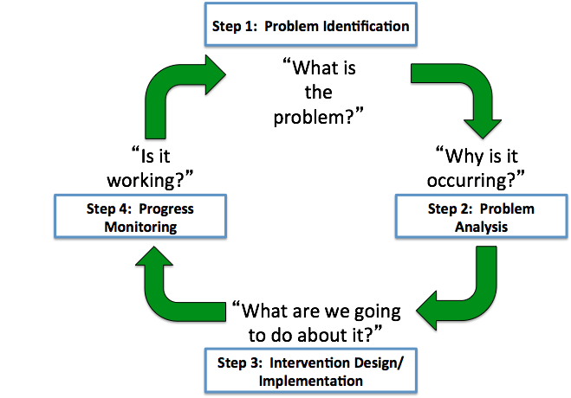
Comprehensive Intervention Design
Implementation Blueprint
4 Step PSP
CID
Step 3:

Slide 15
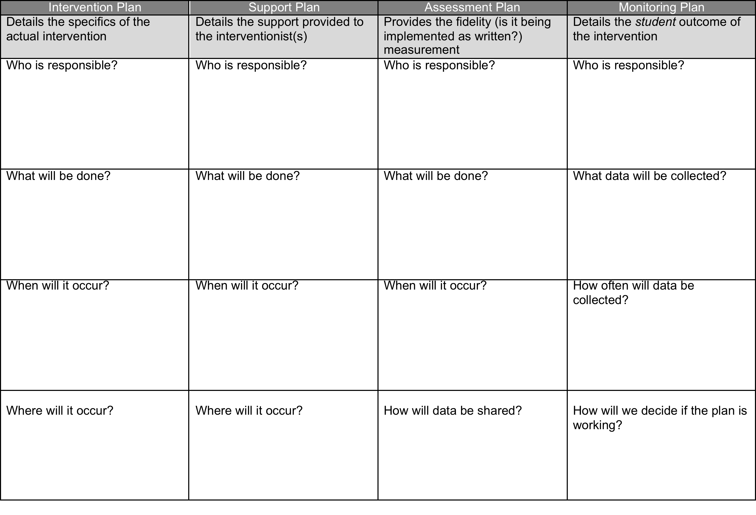
Comprehensive Intervention Design

Slide 16
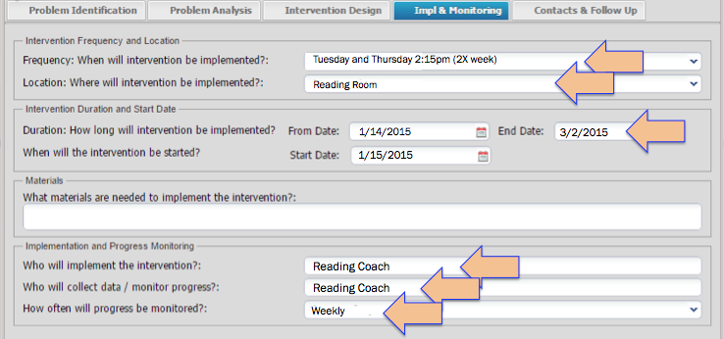
Intervention Plan
documented in BASIS in Tier records
provides details of actual plan
answers who, what, when and where
written in operational and detailed terms so anyone stepping in can follow the plan
When
Where
When
What
Who
Who
When

Slide 17
Support Plan
has not been added to BASIS (yet)
details the support provided to the interventionist to ensure that the plan can be implemented
may bring in other resources: people, time, materials
Who | What | When | Where
Debbie DoGood, (Parapro from other classroom) Frank Furter, if DD is unavailable | will supervise class’s independent work time while teacher works with small intervention group | at 2:15 – 2:45pm every Tuesday and Thursday | DD will come to Teacher’s classroom

Slide 18
Assessment Plan
details the the assessments needed to ensure that the plan is being implemented with fidelity
Who | What | When | How shared
Charlie Brown (Assistant Principal) | will ensure DD is is made available will create a sign in log for DD in classroom will review curriculum for intervention group with teacher | every other Thursday, starting next week | data will be shared with RtI:B Team in meeting on 1/18/16

Slide 19
Monitoring Plan
details the student outcome of the intervention
collection of measurable, observable data to evaluate
Who | What | When | Shared / Criteria
John Doe (Guidance) | will collect student work and assessment samples from teacher, analyze, and graph | every other Thursday at 3:00pm, starting next week | analyzed data will be shared in graph format with RtI:B Team in meeting on 1/18/16 Good outcome = 70% of intervention group >80% average on assessments

Slide 20
Break-out Sessions: 50 minutes each
Faculty Commitment
Micque Feldman
Amber Boles
4 Step PSP
Valerie Blackwell
Vince Watson
BASIS Entry
Georeanne Nigro
10 Minute switch time
Break-out Sessions: 50 minutes each
Wrap UP

Slide 21
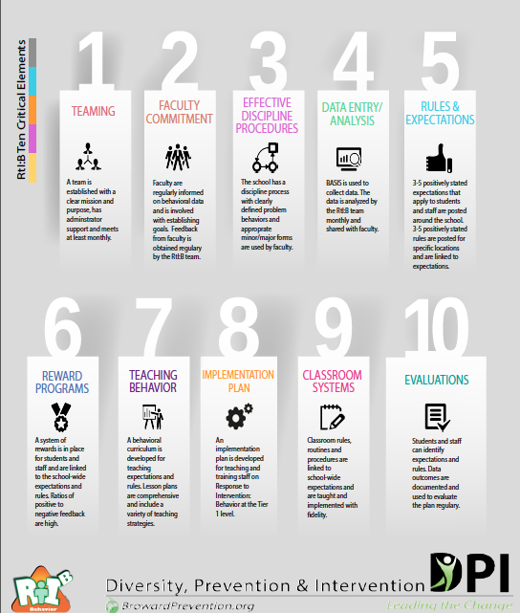
Wrap Up
Report out from sessions
Q and A
Binders
Post Survey = gift!!
Please complete your Post Survey at:
https://www.surveymonkey.com/r/J7D866V

Slide 22



Contact Information
Diversity, Prevention & Intervention
Lauderdale Manors Resource Center
754-321-1655
or visit our website at:
www.browardprevention.org
@ Broward, Prevention & Intervention
@ DiversityBCPS
Notes:
If you have any questions or need any further information about the 4 Step Problem solving process, please contact our office at 754-321-1655 or visit our website.

