Slide 1
PBIS Booster
November 9th 2016
WELCOME!
Please complete your Pre Survey at:
https://www.surveymonkey.com/r/Booster16

Slide 2
Agenda
8:30-8:50 Welcome & PBIS in Broward Data Review
8:50- 10:20
  Teaching Behavior and Implementation Planning
  Action plans
10:20-10:30 Break/transition to break-out groups
10:30-11:30: HERO Schools group
Non-HERO Schools group

Slide 3
Goal 1: Number of PBIS Schools
EoY 14/15 Total = 28 schools
Target 15/16: 35 schools (25% increase)
þ Goal met: 40 schools = 32% increase

Slide 4
Goal 2: Ongoing support
Newsletter: Monthly
Webinars: 10 Critical Elements (monthly)
Booster 1: 12/16/2015 (51% attendance)
Booster 2: 3/17/2016 (51% attendance)
Target 15/16: Continue support
þ Goal met: support provided

Slide 5
Goal 3a: External Suspensions
EoY 14/15 Average for PBIS schools: 9.0 ES per 100
Target 15/16 = 6.8 ES per 100 (25% reduction)
ý Goal not met: 7.9 ES per 100 (12.5% reduction)

Slide 6
Goal 3b: Internal Suspensions
EoY 14/15 Average for PBIS schools: 54.6 IS per 100
Target 15/16 = 41 per 100 (25% reduction)
þ Goal met: 18.1 per 100 = 67% decrease

Slide 7
Goal 4: Office Discipline Referrals
EoY 14/15 Average for PBIS schools: 707 referrals
Target 15/16 = 530 referrals (25% decrease)
þ Goal met: 345 referrals = 51% decrease

Slide 8
Goal 5a: RtI:B Implementation
(BoQ fidelity = >70%)
EoY 14/15 BoQ Average: 47.5%
Target 15/16= 76% (25% increase)
þ Goal met: 78% = 30% increase

Slide 9
Goal 5b: RtI:B Implementation
(BoQ fidelity = >70%)
EoY 14/15 for PBIS schools: 21% schools at fidelity
Target 15/16 = 26% schools at fidelity (24% increase)
þ Goal met: 77% schools at fidelity= 266% increase

Slide 10
Goal 7: SPBP Scores
EoY 15/16 Average for PBIS schools: 87%
EoY 15/16 Average for District: 78%
EoY 14/15 PBIS schools >80% = 82% schools
Target 15/16 = 90% schools (25% increase)
ý Goal not met: 77.5% schools

Slide 11
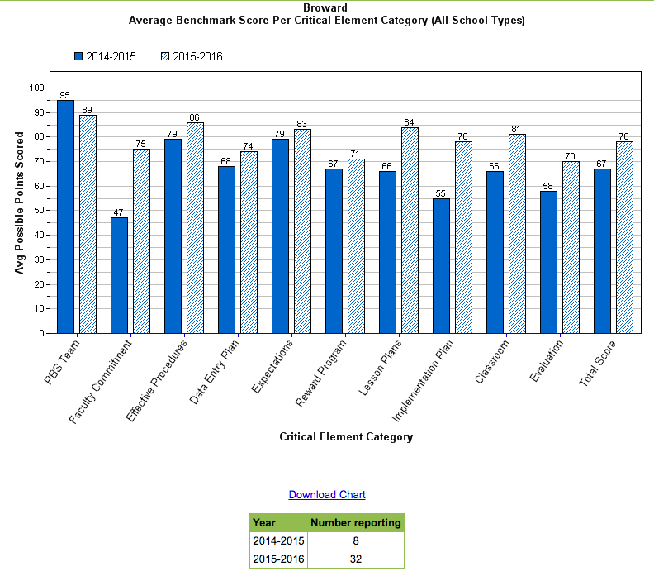

Slide 12
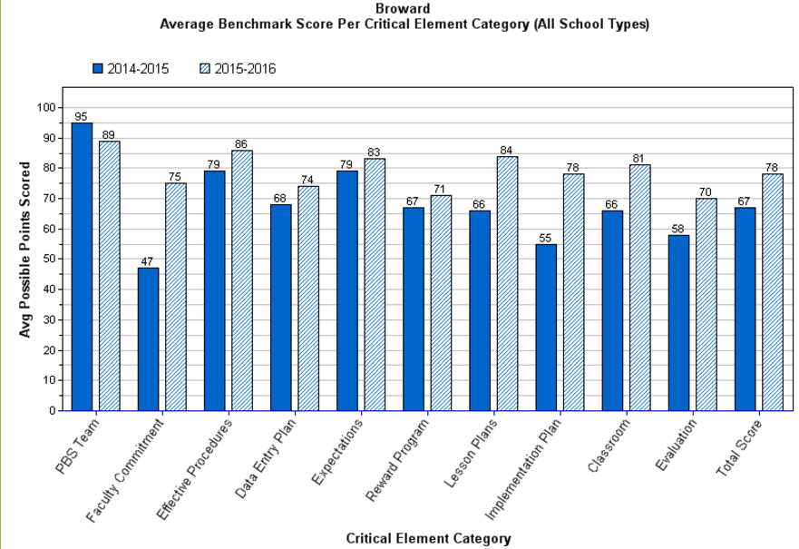
Teaching Behavior (BoQ items 29-33)
29. A behavioral curriculum includes teaching expectations and rules.
30. Lessons include examples and non-examples
31. Lessons use a variety of teaching strategies
32. Lessons are embedded into subject area curriculum
33. Faculty/staff and students are involved in development & delivery of behavioral curriculum
34. Strategies to share key features of SWPBIS program with families/community are developed and implemented

Slide 13
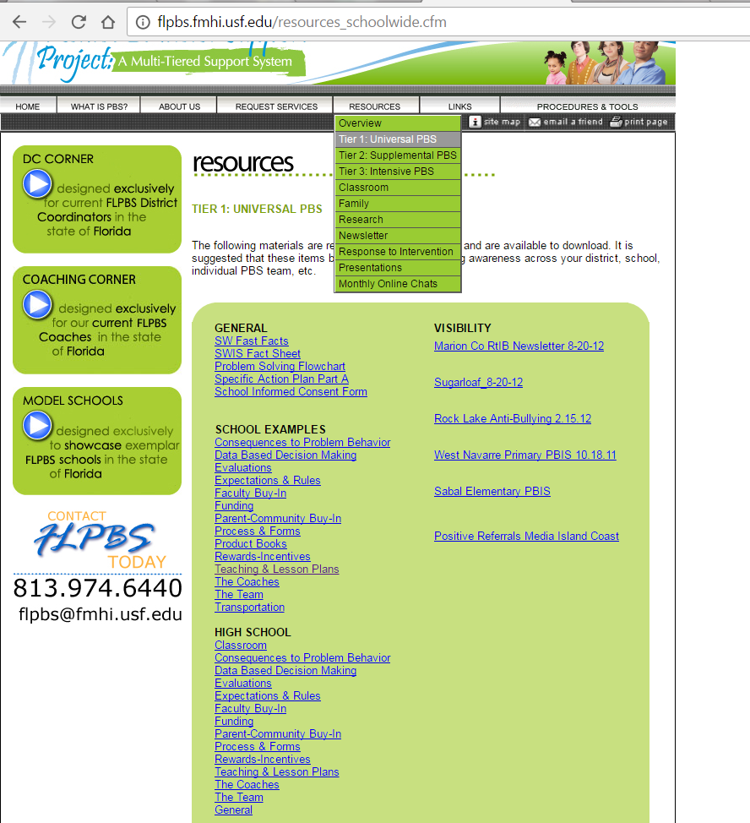
29. A behavioral curriculum includes teaching expectations and rules.
30. Lessons include examples and non-examples
Considerations:
  Provide lesson plans to teachers; make them easily accessible and editable
  Provide demonstrations of how to deliver lesson plans effectively
    Videos
      https://louisville.edu/education/abri/training.html
      Explicitinstruction.org
    Live demos
  Ensure critical features included
    Rationale, definition (non-examples/examples), model, opp. to practice, feedback
Notes:
29. A behavioral curriculum includes teaching expectations and rules.
30. Lessons include examples and non-examples
Considerations:
Provide lesson plans to teachers; make them easily accessible and editable
Shared files, dropbox, website icons, outlook
Provide demonstrations of how to deliver lesson plans effectively
Videos: Create videos; find videos (explicitinstruction.org; abri videos)
Live demos
Ensure critical features included

Slide 14
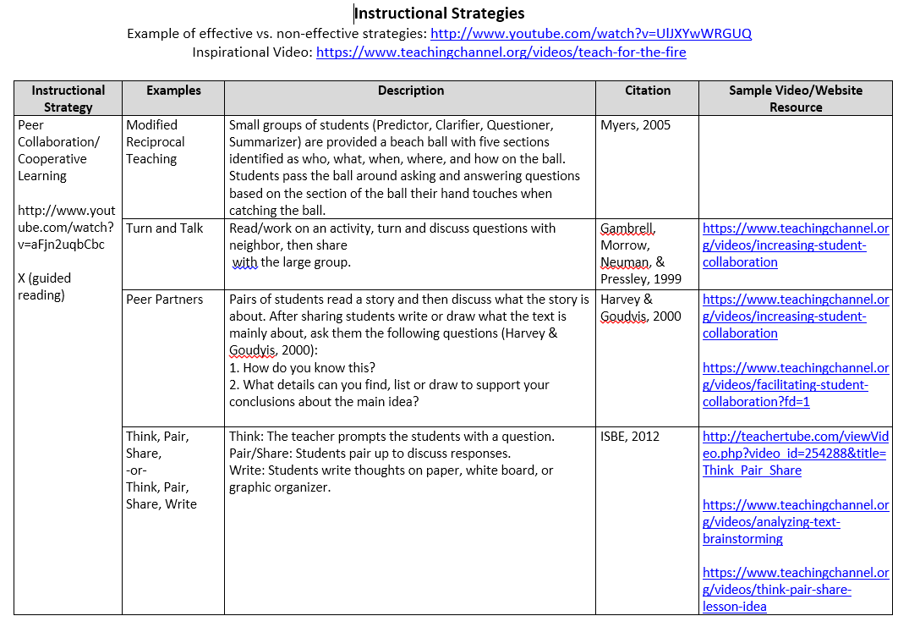
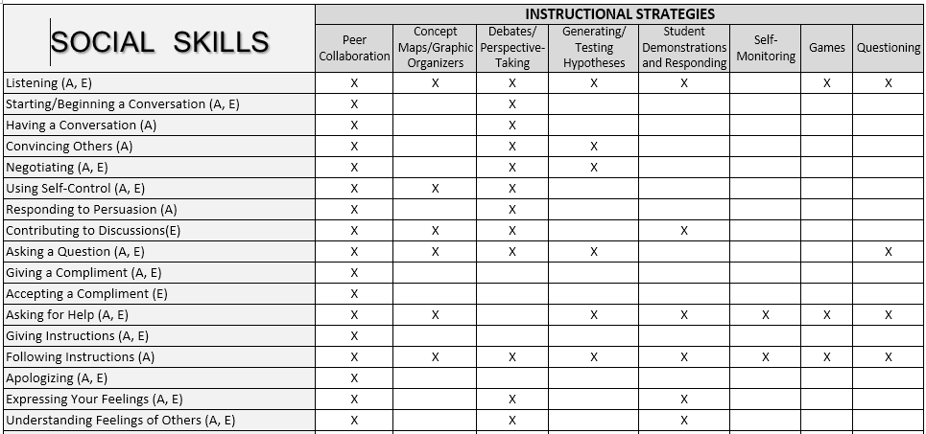
31. Lessons use a variety of teaching strategies
Notes:
31. Lessons use a variety of teaching strategies
32. Lessons are embedded into subject area curriculum
33. Faculty/staff and students are involved in development & delivery of behavioral curriculum
34. Strategies to share key features of SWPBIS program with families/community are developed and implemented

Slide 15
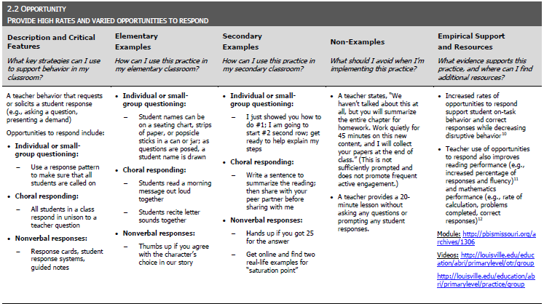
31. Lessons use a variety of teaching strategies
Notes:
31. Lessons use a variety of teaching strategies
32. Lessons are embedded into subject area curriculum
33. Faculty/staff and students are involved in development & delivery of behavioral curriculum
34. Strategies to share key features of SWPBIS program with families/community are developed and implemented

Slide 16
32. Lessons are embedded into subject area curriculum
All Content Areas:
  Use each expectation as a “Word of the Week” on word walls
    Look up synonyms and antonyms for the expectations
    Informational text (scientific, technical, historical, nonfiction), as well as literature (stories, drama, poetry)
Social Studies:
  Talk about how certain historical events occurred because of conflict and come up with solutions on how the conflict could have been resolved
  Identify a character in history who exemplified a Tier 1 expectation
Language Arts and Reading:
  Discuss characters in a novel and how they did/did not show respect, then have the students write the story with the character showing respect
  Read a book whose moral aligns with a Tier 1 expectation
Fine Arts (Music, Art, Computers, Graphics):
  Have the students compose a song/rap, poem, etc. using the expectations
  Students may design a poster depicting one of the expectations
Notes:
32. Lessons are embedded into subject area curriculum
2 pts: Nearly all teachers embed behavior teaching into subject area curriculum on a daily basis.
1 pt: About 50% of teachers embed behavior teaching into subject area curriculum or embed behavior teaching fewer than 3 times per week
0 pts: Less than 50% of all teachers embed behavior teaching into subject area curriculum or only occasionally remember to include behavior teaching in subject areas.
33. Faculty/staff and students are involved in development & delivery of behavioral curriculum
34. Strategies to share key features of SWPBIS program with families/community are developed and implemented

Slide 17
32. Lessons are embedded into subject area curriculum
Science and/or Math:
  Have students count the number of tickets redeemed monthly for prizes & graph them. Include ratio of number of tickets to student, # of tickets per teacher, etc.
  Use the scientific method to investigate a Tier 1 problem behavior
Family Engagement:
  Make families aware of the schedule for teaching the behavioral curriculum and provide them with resources to support behavioral skills at home.
    Example: 1) Suggest or provide videos/books that support ‘Being Responsible’ or ‘Following Directions’; 2) Provide parents with discussion questions or activities for families to do together prior to and following the video or book.
Service Learning:
  Have older students on campus develop story/picture books using the expectations
  Pair a high school student with an elementary school student for a mentoring program
FCAT Writing Prompt:
  Persuasion: Ask students to identify what they think the expectations should be
  Expository: What are the Tier 1 expectations and what do they mean?
Notes:
Nearly all teachers embed behavior teaching into subject area curriculum on a daily basis.

Slide 18
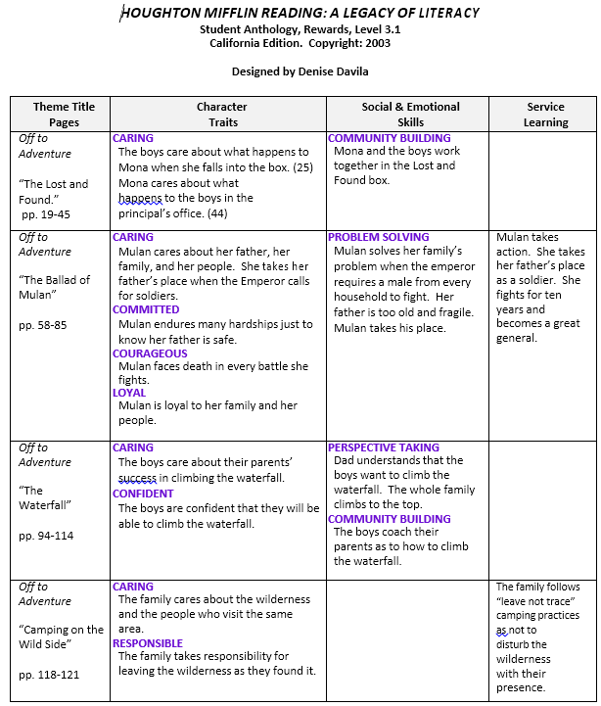
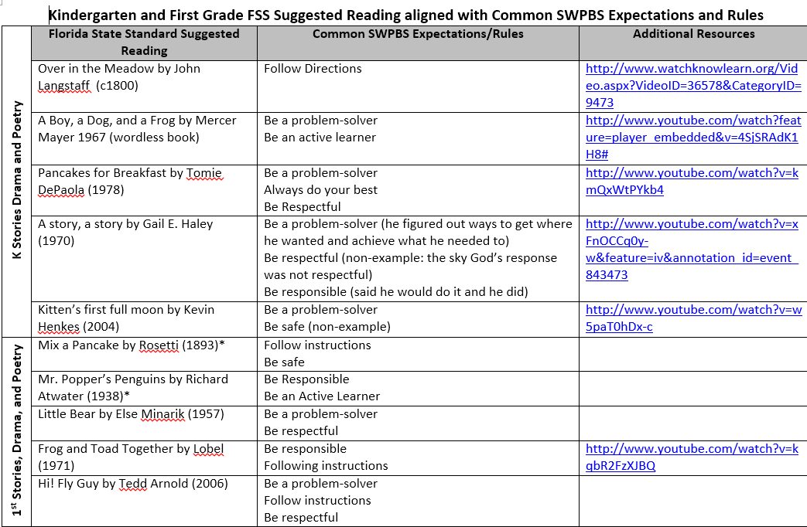
32. Lessons are embedded into subject area curriculum
Notes:
32. Lessons are embedded into subject area curriculum
33. Faculty/staff and students are involved in development & delivery of behavioral curriculum
34. Strategies to share key features of SWPBIS program with families/community are developed and implemented

Slide 19
33. Faculty/staff are involved in development & delivery of behavioral curriculum
What are you getting input on?
  Brainstorm revisions to existing templates to fit issues in classrooms and align and integrate within content areas/grade levels
  Needs for delivery (time, modeling, support)
  Others?
How are you getting input?
  Department meetings; grade-level PLCs, staff meetings, emails, front office posters (incentivize participation, create contests)
  Others?
Notes:
29. A behavioral curriculum includes teaching expectations and rules.
30. Lessons include examples and non-examples
31. Lessons use a variety of teaching strategies
32. Lessons are embedded into subject area curriculum
33. Faculty/staff and students are involved in development & delivery of behavioral curriculum
34. Strategies to share key features of SWPBIS program with families/community are developed and implemented

Slide 20
34. Strategies to share key features of SWPBIS program with families/community are developed and implemented
What are the current ways your school communicates schoolwide and/or classroom level information with families?
How effective are those strategies? How do you know?
Ask families for their communication preferences
Notes:
34. Strategies to share key features of SWPBIS program with families/community are developed and implemented
1 pt: The PBIS Plan includes strategies to reinforce lessons with families and the community (i.e., after‐school programs teach expectations, newsletters with tips for meeting expectations at home)

Slide 21
Implementation Planning (BoQ Items 35-41)
35. A curriculum to teach the components of the discipline system to all staff is developed and used
36. Plans for training staff how to teach expectations/rules/rewards are developed, scheduled and delivered
37. A plan for teaching students expectations/rules/rewards is developed scheduled and delivered
38. Booster sessions for students and staff are planned, scheduled, and delivered
39. Schedule for rewards/incentives for the year is planned
40. Plans for orienting incoming staff and students are developed and implemented
41. Plans for involving families/community are developed & implemented
Notes:
35. A curriculum to teach the components of the discipline system to all staff is developed and used
36. Plans for training staff how to teach expectations/rules/rewards are developed, scheduled and delivered
37. A plan for teaching students expectations/rules/rewards is developed scheduled and delivered
38. Booster sessions for students and staff are planned, scheduled, and delivered
39. Schedule for rewards/incentives for the year is planned
40. Plans for orienting incoming staff and students are developed and implemented
41. Plans for involving families/community are developed & implemented

Slide 22
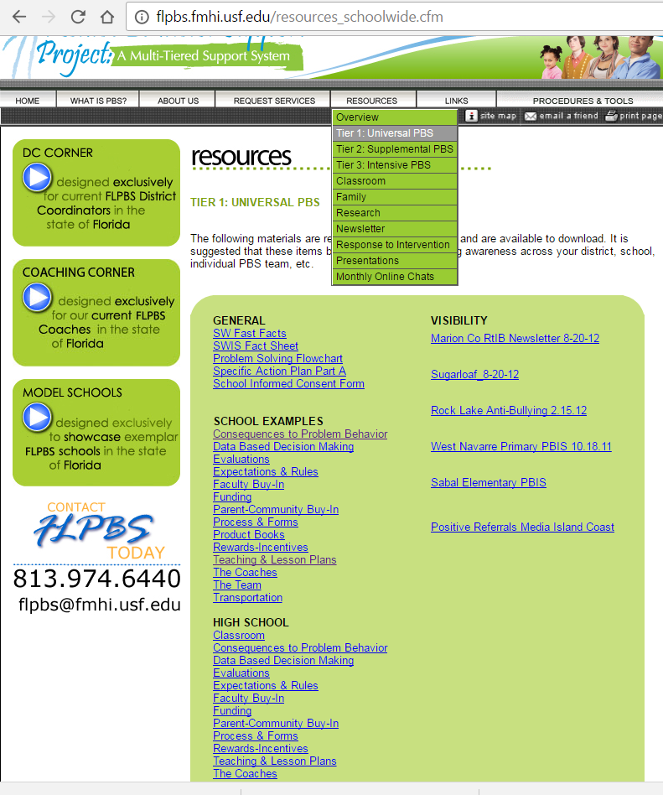
35. A curriculum to teach the components of the discipline system to all staff is developed and used
Components:
  Referral process (flowchart),
  Definitions of problem behaviors,
  Explanation of major vs. minor forms,
  How the data will be used to guide the team in decision making.
Notes:
35. A curriculum to teach the components of the discipline system to all staff is developed and used
2pts: The team scheduled time to present and train faculty and staff on the discipline procedures and data system including checks for accuracy of information or comprehension. Training included all components: referral process (flowchart), definitions of problem behaviors, explanation of major vs. minor forms, and how the data will be used to guide the team in decision making.
1 pt.: The team scheduled time to present and train faculty and staff on the discipline procedures and data system, but there were no checks for accuracy of information or comprehension. OR training did not include all components (i.e., referral process (flowchart), definitions of problem behaviors, explanation of major vs. minor forms, and how the data will be used to guide the team in decision making.)

Slide 23
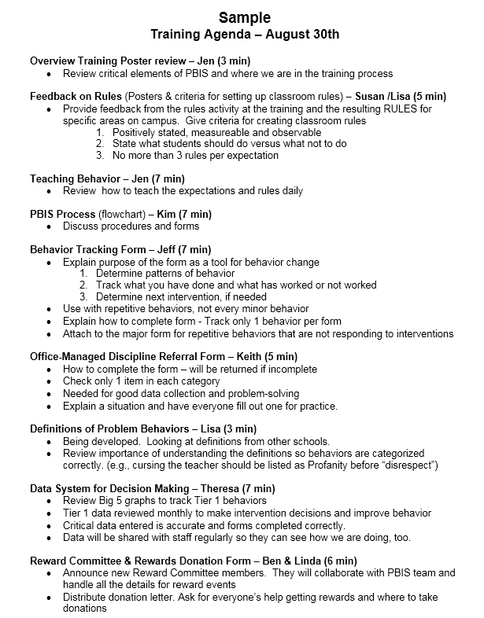
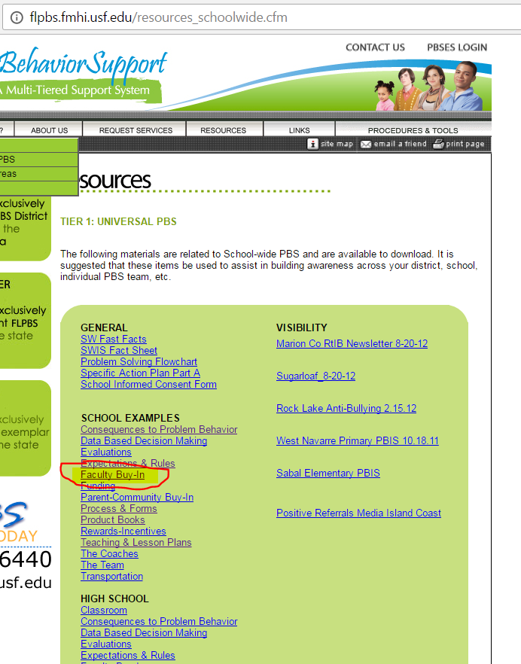
36. Plans for training staff how to teach expectations/rules/rewards are developed, scheduled and delivered
Notes:
35. A curriculum to teach the components of the discipline system to all staff is developed and used
36. Plans for training staff how to teach expectations/rules/rewards are developed, scheduled and delivered
37. A plan for teaching students expectations/rules/rewards is developed scheduled and delivered
38. Booster sessions for students and staff are planned, scheduled, and delivered
39. Schedule for rewards/incentives for the year is planned
40. Plans for orienting incoming staff and students are developed and implemented
41. Plans for involving families/community are developed & implemented

Slide 24
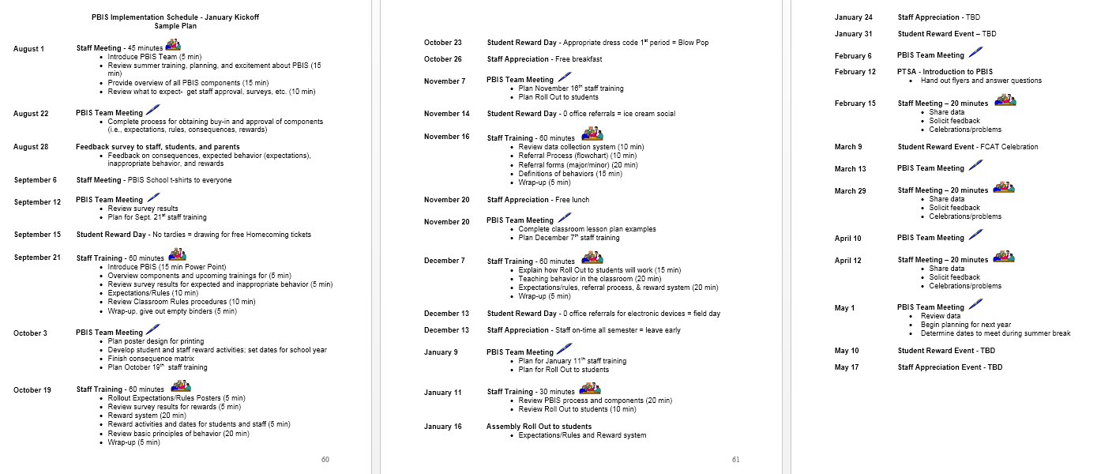
36. Plans for training staff how to teach expectations/rules/rewards are developed, scheduled and delivered
Notes:
35. A curriculum to teach the components of the discipline system to all staff is developed and used
36. Plans for training staff how to teach expectations/rules/rewards are developed, scheduled and delivered
37. A plan for teaching students expectations/rules/rewards is developed scheduled and delivered
38. Booster sessions for students and staff are planned, scheduled, and delivered
39. Schedule for rewards/incentives for the year is planned
40. Plans for orienting incoming staff and students are developed and implemented
41. Plans for involving families/community are developed & implemented

Slide 25
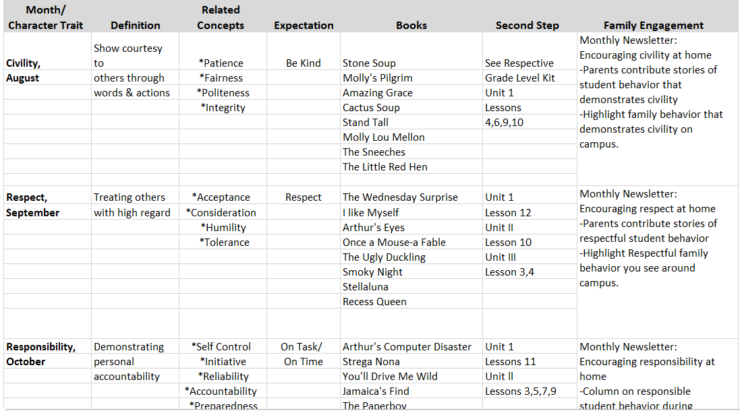
37. A plan for teaching students expectations/rules/rewards is developed scheduled and delivered
Notes:
35. A curriculum to teach the components of the discipline system to all staff is developed and used
36. Plans for training staff how to teach expectations/rules/rewards are developed, scheduled and delivered
37. A plan for teaching students expectations/rules/rewards is developed scheduled and delivered
38. Booster sessions for students and staff are planned, scheduled, and delivered
39. Schedule for rewards/incentives for the year is planned
40. Plans for orienting incoming staff and students are developed and implemented
41. Plans for involving families/community are developed & implemented

Slide 26
38. Booster sessions for students and staff are planned, scheduled, and delivered
39. Schedule for rewards/incentives for the year is planned
40. Plans for orienting incoming staff and students are developed and implemented
Considerations
  New students
  New staff
  Subs
  Visitors (itinerant support staff, mentors, etc.)
  Review data to inform booster schedule and needs
Notes:
35. A curriculum to teach the components of the discipline system to all staff is developed and used
36. Plans for training staff how to teach expectations/rules/rewards are developed, scheduled and delivered
37. A plan for teaching students expectations/rules/rewards is developed scheduled and delivered
38. Booster sessions for students and staff are planned, scheduled, and delivered
39. Schedule for rewards/incentives for the year is planned
40. Plans for orienting incoming staff and students are developed and implemented
41. Plans for involving families/community are developed & implemented

Slide 27
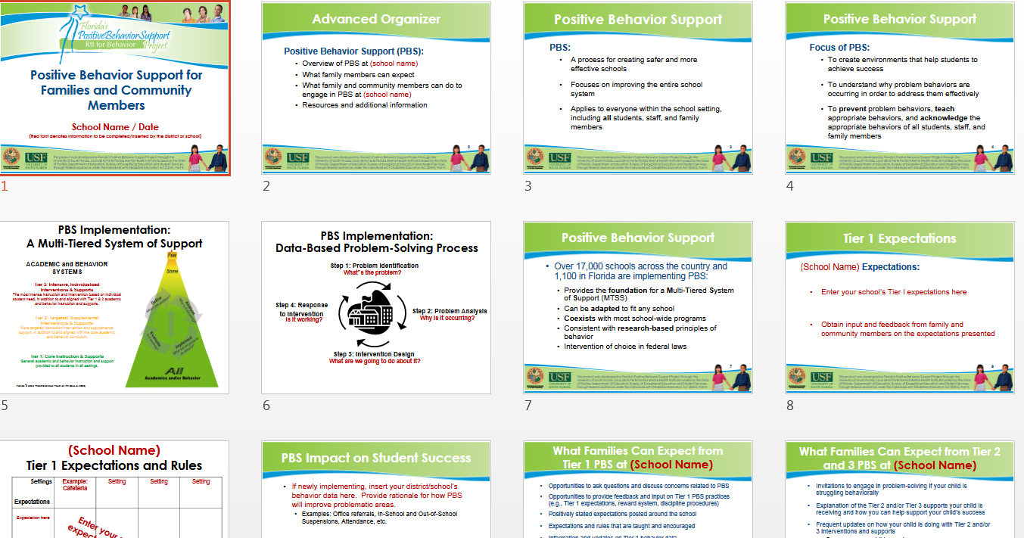
41. Plans for involving families/community are developed & implemented
Positive phone calls/introductions at the beginning of each year
  Has at least 1 teacher from the school contacted each family to establish positive relationships?
Have the expectations and support resources been communicated to families?
Have families been provided with additional information to support expectations at home?
Are tier 1 data shared with families regularly?
Notes:
35. A curriculum to teach the components of the discipline system to all staff is developed and used
36. Plans for training staff how to teach expectations/rules/rewards are developed, scheduled and delivered
37. A plan for teaching students expectations/rules/rewards is developed scheduled and delivered
38. Booster sessions for students and staff are planned, scheduled, and delivered
39. Schedule for rewards/incentives for the year is planned
40. Plans for orienting incoming staff and students are developed and implemented
41. Plans for involving families/community are developed & implemented

Slide 28
PBIS Action Plans
FLPBS Template:
Universal Action Plan for all Critical Elements
flpbs.fmhi.usf.edu/coachescorner.cfm
➔ General ➔ Tier 1 Action Plan Template
Broward Templates:
One Action Plan for each of the 10 Critical Elements
Specific considerations and suggested action steps for that Element
http://www.browardprevention.org/mtssrti/rtib/
➔ PBIS Tier 1 Resources ➔ Reward Program ➔ Action Plan

Slide 29
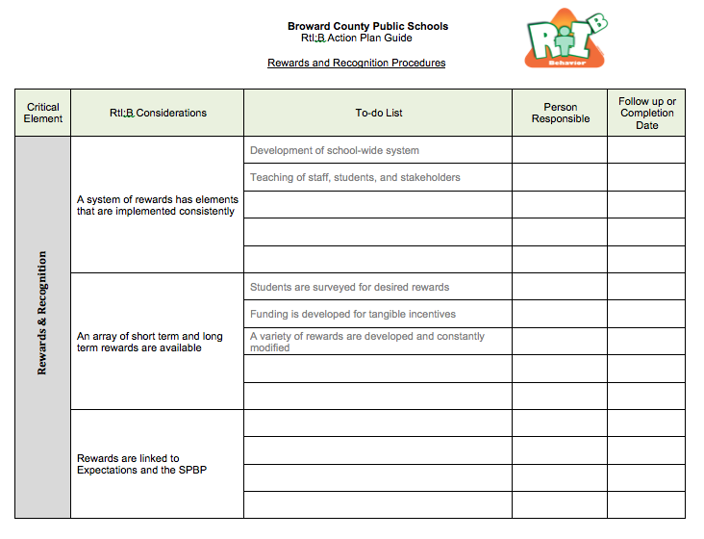
Suggested
Action Steps

Slide 30
Wrap Up
Tier 2 Training: January 20th 2017
Next Booster: February 28th 2017
Next PIC due: March 1st 2017
1 day training (1 day follow up approx. 2 months later)
Register by contacting tyyne.hogan@browardschools.com
Here at OSPA

Slide 31

Wrap Up
Q and A
Post Survey
PBIS Certificate
Please complete your Post Survey at:
https://www.surveymonkey.com/r/PostBooster16

Slide 32



Contact Information
Diversity, Prevention & Intervention
Lauderdale Manors Resource Center
754-321-1655
or visit our website at:
www.browardprevention.org
@ Broward, Prevention & Intervention
@ DiversityBCPS
Notes:
If you have any questions or need any further information about the 4 Step Problem solving process, please contact our office at 754-321-1655 or visit our website.

