Slide 1
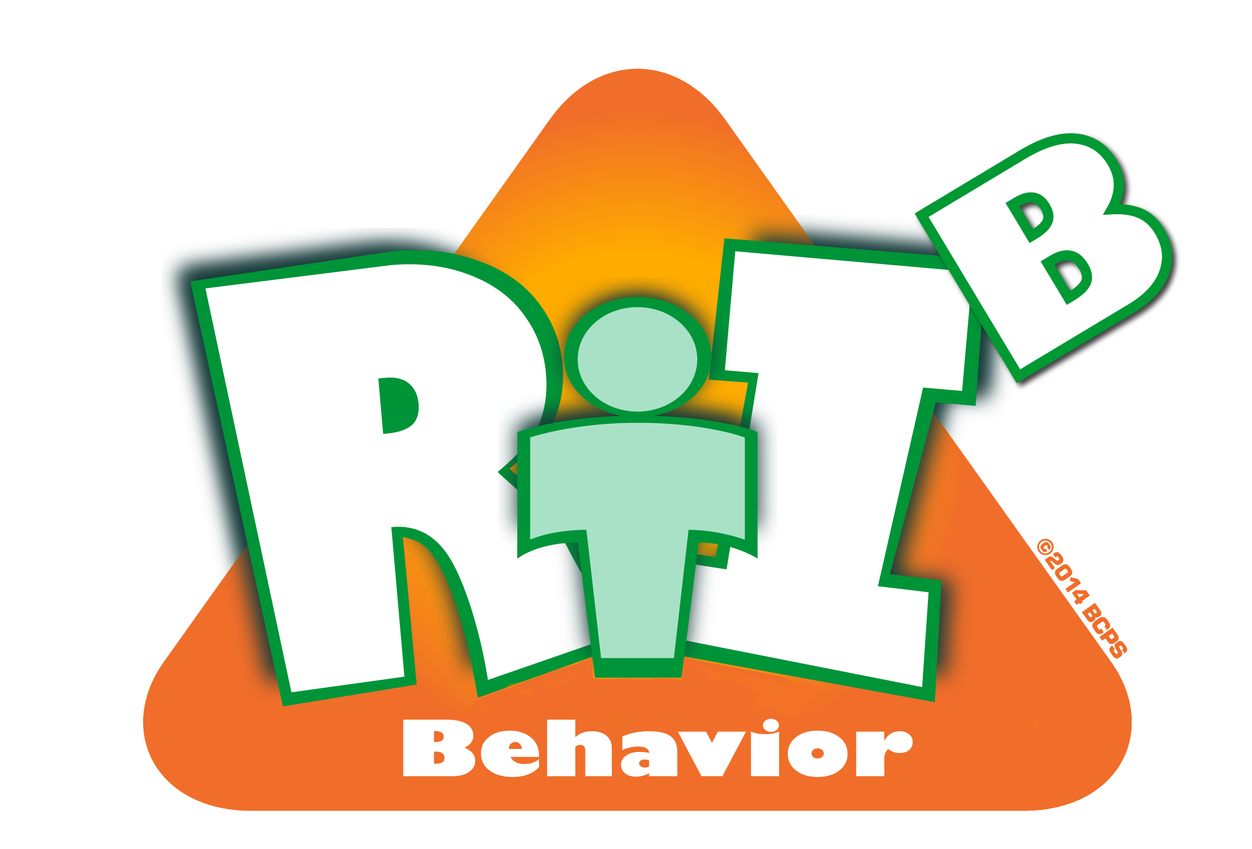
Tier 1
Response to Intervention for Behavior (RtI:B)
Addressing the Behavior of All Students
Notes:
Hello and thank you for joining us today. We like to honor your time so will start promptly at 8:30.
You have logged onto the Tier 1 Response to Intervention for Behavior, or commonly known as RtI:B, Webinar. Tier 1 RtI:B focuses on addressing the behavior needs of ALL students.
My name is Micque Feldman and I am an instructional facilitator for the Diversity, Prevention & Intervention Department. I am joined today by Amber Boles, instructional facilitator and Tyyne Hogan, District Coordinator of RtI for Behavior.
If you have any questions throughout today’s webinar, please type them into the chat box and we will have a question and answer sessions at the end.

Slide 2
District RtI:B Mission Statement
Tier 1 Training Across Broward
To assist RtI:B teams in developing new, positively-oriented strategies that are grounded in research and support at-risk students while helping ALL students become more successful learners and leaders.
Notes:
This District's Mission for RtI:B is to assist school teams in developing new, positively-oriented strategies that are grounded in research
and support at-risk students while helping ALL students become more successful learners and leaders. The District, along with the State of Florida’s Positive Behavior Intervention and Support or PBIS Project provides training to schools in Broward County with developing a Tier 1 Behavior Curriculum.

Slide 3
Response to Intervention for Behavior
RtI:B Webinar Series
Training Opportunity:
  To review all 10 critical elements of Tier 1
  Behavior Curriculum via monthly webinars
  Today’s Webinar:
  Critical Element #3
  Effective Procedures for Discipline
Resource: ‘Webinar Schedule’ in Attachments
Notes:
This year’s webinar series will review all 10 critical elements of Tier 1 Behavior. Today’s session will focus on the third critical element of RtI:B, Effective Discipline Procedures. Don’t forget to download the webinar schedule located in the attachments. Before we begin, I will be posting poll questions for you to answer in order for me to get to know todays audience.
First question: What is your current school position?
Second Question: What level of education do you currently support?
Third Question: How long have you been implementing a Tier 1 Positive Behavior Plan for RtI:B at your school?
Fourth Question: Using the 1-4 Learning Scale, What is your current level of understanding of Tier 1 RtI:B Effective Discipline Procedures?
Fifth Question: How confident are you with creating discipline procedures at your school?

Slide 4
RtI:B Tier 1 Ten Critical Elements
RtI:B Team, Administrative Support
Faculty Commitment
Effective Procedures for Discipline
Data Entry & Analysis
Expectations & Rules
Reward/Recognition Program
Lesson Plans for Teaching Behavior
Implementation Plan
Classroom PBS Systems (CHAMPs)
Evaluation
⬅
Resource: See ‘10 Critical Elements in attachments’
Notes:
As we already know there are ten critical elements that make up the Tier 1 RtI: Behavior model. Today we will take a closer look at how to create an effective discipline procedure to support your Positive Behavior Plan. It is essential to create discipline procedures with your plan as well as ongoing commitment throughout years of implementation.

Slide 5
Poll Questions
Notes:
I am going to post a few poll questions to get a better understanding of my audience.

Slide 6
Effective Discipline Procedures
Definitions
Developing Effective Responses to Problem Behavior
Forms and Data Collection
Developing a Coherent Office Discipline Referral Process
Notes:
Effective discipline procedures can be broken down into 4 components. Each of these components is an important element in an effective plan.
Definitions are critical to ensure that all stakeholders are identifying the same behaviors. Developing responses to behavior will enhance the effectiveness of the consequence being used to correct the inappropriate behavior. Utilizing uniform forms enables your school to collect and track data to evaluate how well your plan is working. And lastly having a process in place ensures that all stakeholders are aware of who and how inappropriate behaviors will be handled. We will discuss each of these areas in depth now.

Slide 7
Effective Discipline Procedures
Definitions
Notes:
Let’s begin with the first component- Defining the behaviors. It is critical that problem behaviors are defined and all staff are trained on what a specific misbehavior looks like. How can our data be accurate if we all have different ideas of what it means to be disrespectful? If the entire staff witnessed a student engaged in inappropriate behavior, would we all be able to classify the behavior in the same way on the referral form? The first step in creating an effective plan is to ensure everyone understands how to define the behaviors.

Slide 8
Sources for Defining Problem Behaviors
District Code of Conduct
Discipline Matrix
District database
RtI:B Database
School Environmental Safety Incident Report –SESIR Districts are required to report data to DOE
  www.fldoe.org/safeschools/sesir
Notes:
The State of Florida’s incident definitions and guidelines have been established by the School Environmental Safety Incident Report. SESIR does not cover all types of behaviors, only those more severe ones (i.e. bullying, fighting, weapons, drugs, etc.). For these behaviors the determined definitions must be used.
Broward County also has a discipline matrix. The Discipline Matrix is a tool for administrators to respond appropriately when students have committed serious violations, per the Code of Student Conduct. This tool is designed to offer consistency at all levels across the District so that students are disciplined fairly from school to school when their behavior requires punishment beyond the classroom. There are two different versions of the Matrix: One to assign consequences to elementary students (grades K-5) and one to assign consequences to secondary students (grades 6-12). The matrix does not define responses to behaviors that are handled in the classroom. For classroom and minor behaviors each school should create a matrix that clearly defines what those behaviors look like and how they are handled.

Slide 9
Defining Incident Levels
Office-Managed Incidents (Majors)
    Handled by the administration
    Physical fights, property damage, weapons, tobacco
Teacher-Managed Incidents (Minors)
    Handled quickly and efficiently
    Typically by the classroom teacher
    Handled where incident occurred
    Tardy, lack of materials, incomplete assignments, gum chewing
Crisis Incidents
    Require an immediate response from administration and/or crisis response team
    Bomb Threats, weapons alerts, intruder, fire evacuations, etc.
    *Consult district and school policies for crisis incidents
Notes:
A clear distinction must exist between problem behaviors that are teacher/staff managed versus problem behaviors that are office-managed or crisis.
Crisis incidents require immediate response from the administrative team. The District has policies in place for Crisis incidents. These incidents must be reported to SESIR, and consequences are clearly laid out in the discipline matrix.
Teacher managed incidents are minor events that are quickly and efficiently handled in the classroom or location in which the incident occurred.
Office managed incidents are those incidents that must be handled by an administrator. They may not be handled immediately but they are recorded and submitted to the office for action.

Slide 10
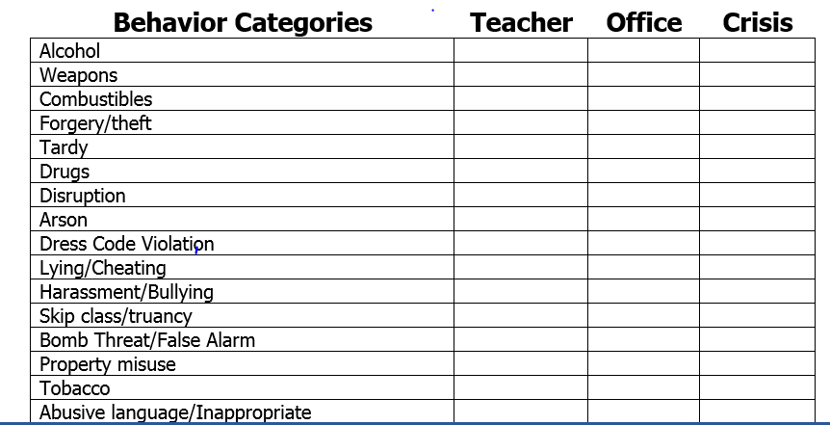
Resource: ‘Behavior category worksheet’ in Attachments
Notes:
This slide is an example of some possible behavior categories and the 3 ways that they may be handled. Each type of behavior should have an assigned level of response. For example Alcohol, weapons or drugs would be incidents that are office or crisis managed. Dress code violation would be handled by the teacher. The school discipline team should look at current school data for behavior and determine which offenses are most common on the campus. These inappropriate behaviors should then be identified as teacher or office managed and possible consequences that can be applied for each type of offense. This is not an all inclusive list. A complete copy of this form is in the attachments folder of the webinar and can be downloaded if you would like to use it.

Slide 11
Why do we define behaviors?
Teacher 1
Student taps pencil on his desk
Response: Writes an office discipline referral
Student is removed from class reports to office
Student loses 1 hour of instructional time
Teacher 2
Student taps pencil on his desk
Response: Teacher uses a menu of consequences
1)verbal warning.
2)Move behavior clip
3)Write in behavior log
Student stays in class and continues learning
Notes:
When we define behaviors we are ensuring that all faculty and staff are responding to behaviors with equality. Removing a student from the classroom for minor misbehaviors is not in the best interest of the student. Lost instructional time for both the misbehaving student and the rest of the class is not correcting the behavior. In fact it may be increasing the behavior if the student wanted to avoid the lesson. When teachers are clear which behaviors they can handle in the classroom, they can create a classroom behavior plan that allows for quick and efficient responses. It is also important that they know which incidents should be handled by the office and which require immediate removal of the student to the office. In this example Teacher 1 reacted by sending the student to the office for tapping his pencil on the desk. This response to the behavior required her to stop instruction and write a referral form and arrange for the student to be escorted to the office. This response probably took 10 minutes of instruction away from the class. Teacher 2 has a menu of consequences which she uses to respond to inappropriate behaviors. A quick verbal warning and reminder of the expected behavior. If the student continues to tap his pencil she will quietly ask HIM to go move his behavior clip. All the while she continues with class instruction. Too often students are sent to the office and the administration is not available to respond at that time. These students often spend 30 minutes or more waiting in the office when they should be in the classroom receiving instruction. Only major incidents should be sent to the office immediately.

Slide 12
Resource: ‘Discipline Mgmnt Grid’ in Attachments
Possible Teacher-Managed Behaviors
Teacher-Managed Behaviors | State Rule | Model Exp Behavior | Student Practices | Recognize Effort | Peer Mediation | Redirection | Prompt | Reward Alternative Behavior | Apology | Contract
Gum Chewing
Talking out of turn
Inappropriate verbal language
Physical contact
Defiance/disrespect/ non-compliance
Property misuse
Disruption
Notes:
Here is a sample of a matrix listing teacher managed behaviors. The inappropriate behaviors are listed down the left side of the chart. (Click for arrow). The possible consequences are listed across the top. (click for arrow). These consequences are listed in order of their severity. Creating a student contract is more serious than modeling appropriate behavior.

Slide 13
Possible Administrative Decisions
Office-Managed Behavior Categories | Conference with Student | Individualized Instruction | Time in Office | Loss of Privilege | Parent Contact | Time Out/Detention | Saturday School | In-school Suspension | Out-of-school Suspension | Expulsion
Abusive/Inappropriate Language
Alcohol
Arson
Bomb threat/False alarm
Combustibles
Defiance/Disrespect/ Insubordination/ Non-compliance
Disruption
Dress Code Violation
Fighting/Physical Aggression
Forgery/Theft
Harassment/Tease/Taunt
Lying/Cheating
Other Drugs
Property Damage
Skip class/Truancy
Tardy
Tobacco
Vandalism/Property Damage
Weapons
Resource: ‘Discipline Mgmnt Grid’ in Attachments
Notes:
These are some office managed behaviors. Again the possible consequences are listed across the top. These consequences can be school specific. Your campus may have different types of behaviors and your students may require consequences that are more or less severe for those behaviors. This matrix should be created by the discipline team at each school with feedback and suggestions from all stakeholders- teachers, staff, administration, and parents. A complete sample as well as a blank form are provided in the attachments tab for your use.

Slide 14
Effective Discipline Procedures
Developing Effective Responses to Problem Behavior
Notes:
14
Now that we have defined the problem behaviors that we will most likely see on our campuses, we must develop an effective way to respond to them when they occur.
Effective consequences are those that are successful in changing the inappropriate behavior. It is critical to understand that the most severe consequences are not always the best. It is important to have consistent school-wide procedures for dealing with problem behaviors and to consider a consequence that makes sense based on the function of the behavior and the severity of the behavior. Taking time to discuss consequence options before problems arise helps to ensure that better decisions will be made since we are not making decisions impulsively and emotionally and reiterates that behavior change is the ultimate goal.
All stakeholders should be included in the development of consequences for students. Administration, faculty and parents should be involved in the process. Your consequences should align with your school wide rules and expectations.

Slide 15
The ABCs of Behavior
A
Antecedent- What happened before the behavior?
B
Behavior- What is the misbehavior?
C
Consequence-What happened after the misbehavior?
Notes:
When we discuss the ABCs of behavior we are determining the prior action or situation that caused or allowed the inappropriate behavior to occur. This prior action or situation is called the antecedent. We are aware of the behavior itself before we determine what caused it and how to respond to it. The response to the behavior is the consequence.

Slide 16
ABCs of Behavior
Antecedents
Behavior
Consequences
Events in the environment that occur prior to a behavior
Observable, measurable actions
Events/responses immediately following a behavior
Increase the likelihood specific behaviors will occur
Reinforces behavior
Informs what skills to teach (Tier 1 Expectation)
Inform interventions (Prevention)
Helps determine function (motivation) of the behavior
Informs effective responses
Notes:
Animation- A, B, C (3 clicks)
When we identify the ABCs it is important to be accurate. The more accurately we define the behavior and the reason that it is occurring the more effective our intervention will be in correcting the behavior.
First click-At Tier 1, You want to identify ABCs that are common for large numbers of students. Large numbers of students arriving late, running in the hallways, or fighting in the bus loop would indicate there is a problem that needs a solution. These are the behaviors that your discipline plan will target.
Click 2- ow that you have identified the behaviors it is time to determine what is the antecedent for the behavior- why is it happening. It could be there is little adult supervision at the bus loop, or faculty is not present in the hallways during transitions. The antecedents not only tell us why a behavior is occurring, they also help to inform the preventions that can be put into place to eliminate the inappropriate behavior.
Click 3-The consequences that follow the behavior can either strengthen or weaken the behavior.
When something desirable follows an appropriate or inappropriate behavior, that behavior is strengthened and more likely to be repeated
When something desirable does NOT follow an appropriate or inappropriate behavior, that behavior is weakened and less likely to be repeated. This is important to remember when putting consequences into place. For example: A student is cracking jokes out loud in the classroom interrupting instruction. He likes the attention he is getting from his peers , every time they laugh with him he tells another joke. If the teacher responds by stopping instruction and correcting the student in front of his peers he is likely to continue the behavior in the future. He got more attention after the consequence was enforced. However if the teacher had quietly moved the student to another seat and continued instruction the student would not get additional attention from his peers. He has no desire to continue the inappropriate behavior since no one is giving him their attention.

Slide 17
Patterns of Behavior
Once you have identified patterns of behavior:
  Proactive (Environmental): try to prevent the behaviors from recurring; look at the antecedents and environment
  Educative (Replacement Behaviors): first we need to making sure we teach/re-teach desired behavior; teach a replacement behavior
  Reinforcement (Encourage appropriate behaviors and discourage problem behaviors): make sure we only reinforce those behavior we desire, are we addressing the function of the behavior, make sure we are not reinforcing the undesired behavior
Notes:
Once you have identified patterns of behavior you can begin to change the behavior. Responses can be proactive, educative or reinforcing. All of these are positive
Responses to a behavior. Proactive responses will look at the environment and what is causing the inappropriate behavior and put a plan in place that prevents the behavior before it happens. Educative involves teaching and re-teaching the appropriate or replacement behavior that is expected. And reinforcement encourages appropriate behaviors by recognizing or rewarding the behavior you desire. It is important to recognize the antecedent when using reinforcement- we do not want to reinforce an inappropriate behavior because it will strengthen and continue. For example: a John is sent for a time out in another classroom each time he acts out in Math class. Rather than decreasing the behavior, the student continues to act out. Further investigation discloses that John likes to go to the other class where he is allowed to use technology and play a math game. The response increased the misbehavior because he was able to avoid the math lesson and play computer games. Knowing the antecedent would enable the teacher to design a more appropriate response to the misbehavior which may result in the behavior change.

Slide 18
Preventing Problem Behavior
(Antecedents)
Develop positive relationships with students
Continuous teaching & rewarding
Active Supervision
Modify the environment and/or instruction
    Traffic flow, tempting materials, line of sight, organization, visual boundaries
    Change schedule
    Interesting & engaging instruction (adapt curriculum, special assignment, tutoring, computer/ internet work, role play)
Provide prompts/Pre-Correction
Provide Choices
Notes:
Here are some specific examples of ways to prevent problem behavior. If you are aware of the antecedents, procedures can be put into place that will prevent inappropriate behaviors. Rewarding students for meeting expectations and following rules will support continued appropriate behaviors.
Consider that these strategies can happen before problem behavior occurs, but also as a response to problem behavior. (Teachers & administrators should consider these as options for responding to problem behavior.) If a student misbehaves & there’s a way to prevent it from happening again, conference w/ the student (problem solve & teach skills), and then make the change to prevent it from happening in the future.
Most of these strategies are a natural fit for classroom-managed behaviors, but many could be used for office-managed behaviors as well. Students at all age levels need to be taught how to behave appropriately. These lessons should be ongoing. All teachers know that rules, expectations and procedures are taught in the first weeks of the school But many also loose sight of the need to repeat lessons and model appropriate behaviors and expectations throughout the year. Especially after long breaks or when data indicates an increase in problem behaviors on campus.

Slide 19
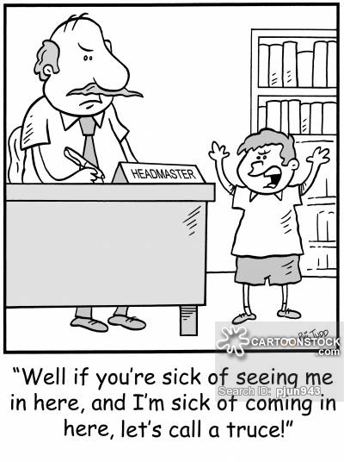
Consequences
Lead to a change in behavior
Can be used for both minor and major incidents
Should be identified in advance
Should be administered effectively
Notes:
Now let’s consider the consequences that are appropriate for the behaviors when they occur. As the cartoon suggests the behavior of this boy isn’t changing, he is returning multiple times to the headmaster. Effective consequences should lead to a change in the behavior, and can be used for both major and minor offenses. It is important to identify in advance what consequences will be used and in what order, 1st offense, 2nd offense and so on. And all consequences should be administered in an appropriate time frame, calmly, and equally to all students.

Slide 20
Consequences
Identify Consequences in Advance
  Increases effectiveness
  Agreement on teacher- vs. office-managed behaviors
  Consensus on range of actions – Classroom and office
  Aligned with Tier 1 expectations and rules
  Multiple options address a variety of functions
  Improves data collection
*Refrain from taking or threatening to take away an earned reward!
Notes:
Identifying consequences in advance and providing teachers with the types of responses and the order in which they should be used is a good practice for ensuring that all stakeholders are responding appropriately. We should not leave the response or consequence up to interpretation. All teachers view behavior differently, and we want to ensure that all behaviors are being responded to in a fair and equitable manner.
Identifying responses to problem behavior in advance and aligning them with the Tier 1 PBIS plan will help them become more effective. Your school behavior Teams should ensure that the behaviors and consequences are tied in with the school wide rules and expectations. As teams plan out their responses to problem behavior, they should keep these guidelines in mind.
There is no silver bullet for problem behavior, no one response has been proven to decrease inappropriate behavior. Teams need to make sure their responses are effective (most of the time). Having multiple options available will ensure faculty have a variety of possible consequences from which to choose for varying functions.

Slide 21
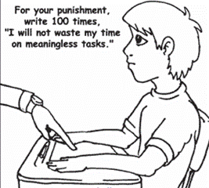
Menu of classroom consequences
1st offence: Verbal warning
2nd offense: lose recess minutes
3rd Offense: time out in another classroom
4th Offense: Parent phone call
5th Offense: Office referral
Notes:
Many teachers utilize a menu of consequences to reinforce their classroom rules and expectations. Here is an example of what a menu may look like. It is important to create an hierarchy when implementing consequences to behaviors. Teacher managed infractions can start early in the day. We don’t want to use all of our possible responses in the morning and have no where to go for the rest of the day. Nor do we want to be in a position of responding with a severe consequence for very minor behaviors and having no consequences available when the inappropriate behaviors escalate and become more severe.

Slide 22
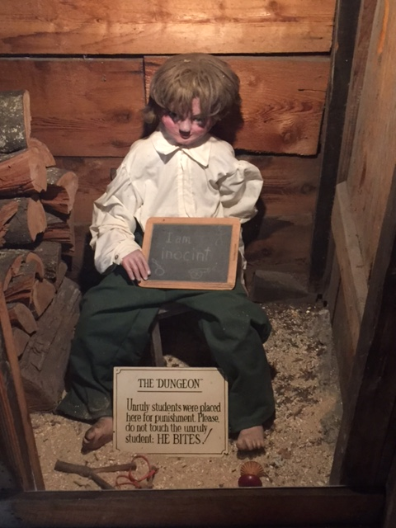
Administering Consequences
  Match the severity of the offense with the consequence
      Office Referrals
      Teacher-Managed behaviors
  Provides an opportunity to learn & practice appropriate behaviors
  Monitor to ensure effectiveness
Notes:
When administering consequences we must consider the severity and number of incidents of the behavior. It is logical that an office managed incident would result in a more severe consequence than a classroom managed behavior. The consequence should include an opportunity for the student to learn and practice the appropriate behavior. There should also be a monitoring piece to follow up and determine if the consequence was effective in changing the behavior. Clearly the punishment of sending this student to the dungeon for classroom managed misbehaviors was not effective. It did not provide an opportunity to learn and practice the appropriate behaviors in the classroom. Seclusion was also not an acceptable response to classroom foolery.

Slide 23
Effective Discipline Procedures
Forms for Data Collection
Notes:
Now we will consider how we can document inappropriate behaviors and their consequences.
When developing forms we must determine what information we need to collect about the incident. And who will need to have access to the information after the incident has been managed.

Slide 24
Minor Forms
TRADITIONALLY
Track # of times behavior occurs
Purely documentation to show:
  Interventions have been tried
  Cover teacher
  Proof for suspension or expulsion
PBS
To discover patterns so that we can change the behavior before it results in a more sever behavior or consequence
Notes:
The use of minor forms is encouraged to support ongoing data collection. Traditionally minor forms were used to track the number of incidents for a particular behavior, and to record what interventions had been tried, which interventions worked, and if necessary a history of incidents should the inappropriate behavior continue and lead to a possible suspension. From a positive behavior support perspective the forms assist in determining a pattern of behavior. If a pattern is determined it is possible to be proactive and change the behavior BEFORE it results in a more severe behavior or consequence.

Slide 25
Referral Forms
Major and Minor Forms
  Meaningful information for data-based problem-solving
  Demonstrate patterns to change behavior
  Document disciplinary actions/interventions
  Generate ideas for interventions
  Align with district/state documentation requirements
  Efficiently record common disciplinary actions
  Adhere to the school’s disciplinary referral process
  Communicate with stakeholders
      Consider limited space for narrative description
      Include enough detail to support data-based
      problem-solving
Notes:
Forms are used for data collection. If we’re going to spend time writing a referral or documenting behavior, we need to make sure we’ve spent our time gathering information that will help us problem-solve effectively. Remember our goal is to change or prevent the inappropriate behaviors on our campus.
“minor forms” are used for classroom-managed referrals. When completing minor forms for teacher managed behavior the emphasis in on the first three bullets : We are gathering information for effective data based problem solving, looking for patterns in the inappropriate behavior that might assist in correcting the behavior, and to document what disciplinary actions or interventions have been put into place. Utilizing minor forms will also encourage adherence to the schools referral process. Written documentation is also useful when ensuring all stakeholders have sufficient information to understand and resolve the problem.

Slide 26
Referral Forms and
Effective Data-Based Problem-Solving
Basic information
  Who
  What
  Where
  When
  Why/Motivation (often missing)
Additional information
  Context: Activity/event occurring at the time of incident
      transition, whole group instruction, seatwork, small group
  Others Involved: Peers, Adults
Notes:
both major & minor forms should include basic information regarding the incident. The who, what, when, where and why of the behavior should be documented. Often the “why” or antecedent of the behavior is missing. This is an important piece when determining the appropriate consequence. Most importantly, forms should have all the information teams need to make good decisions…Whether you are creating new forms or using a form already on your campus, you should make sure that it has all the information needed for the team to make sound effective decisions

Slide 27
Resource: ‘Minor forms #1’ in Attachments
Notes:
Here are some samples of minor forms. These samples are in the attachments file for your use. This form is a check off list. This format makes it easier for the classroom teacher to quickly complete and return to academic instruction.

Slide 28
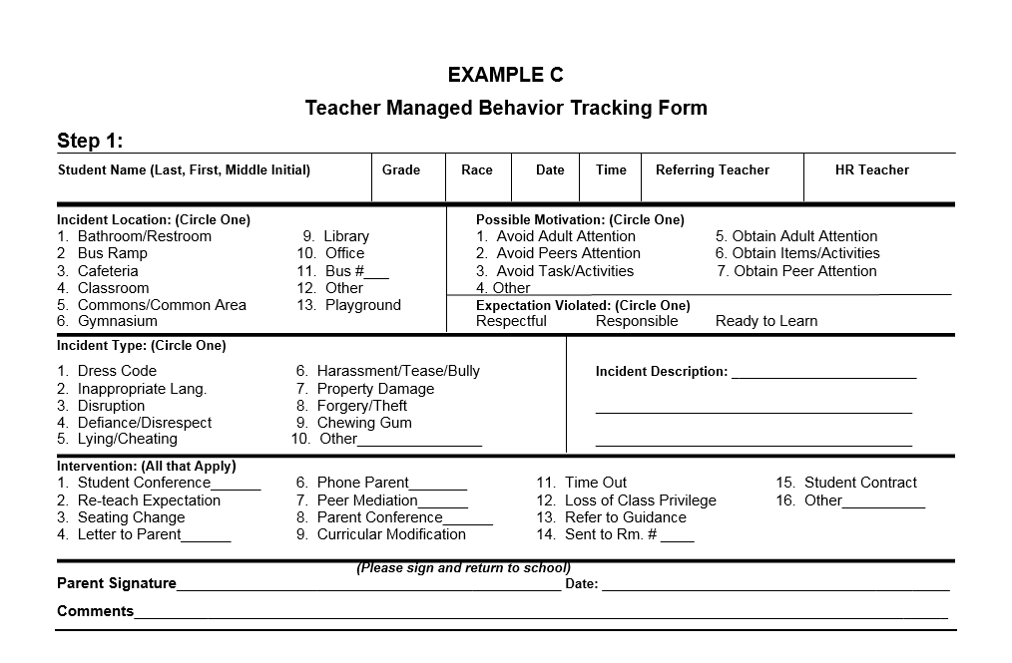
Resource: ‘Minor forms #2’ in Attachments
Notes:
Here is a sample of a minor incident form that could be used by teachers. This form can be used as the parent notification document as well. A copy of this form is in the attachments to this webinar.

Slide 29

BASIS 3.0 is the data collection system for office discipline
Referrals.
Notes:
BASIS 3.0 is the data collection system utilized in Broward County to document office discipline referrals.

Slide 30
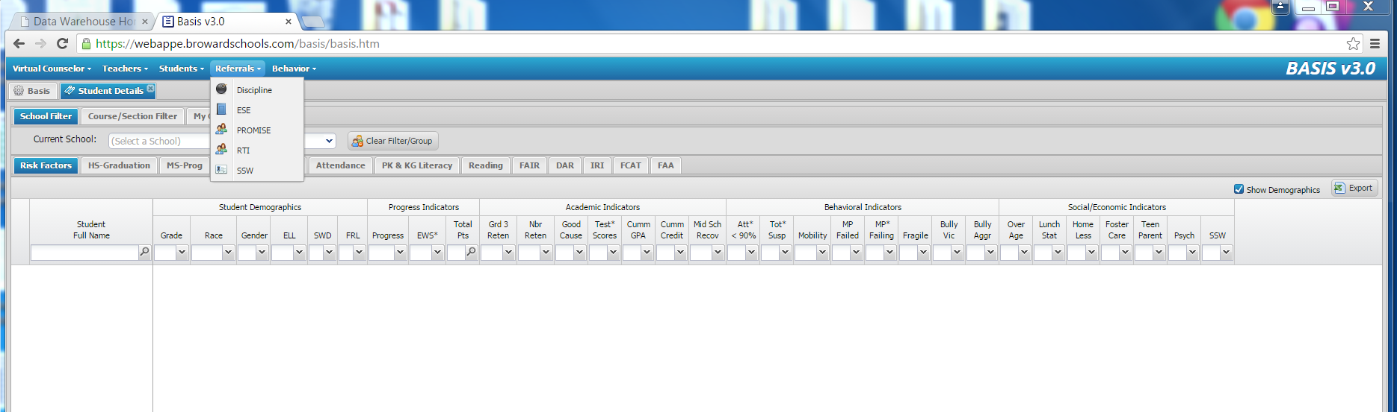
Notes:
Let’s take a quick look at the steps to creating a referral. Once signed in you will Click on the referrals tab at the top of the page. Select discipline from the drop down menu.

Slide 31
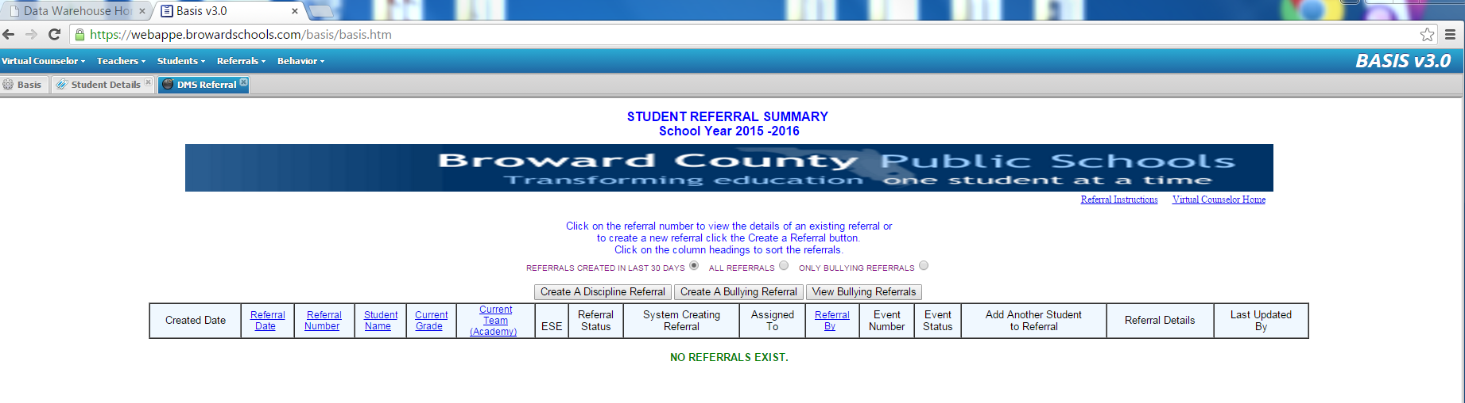
Notes:
Click on the create discipline referral tab. This will bring you to the referral form.

Slide 32
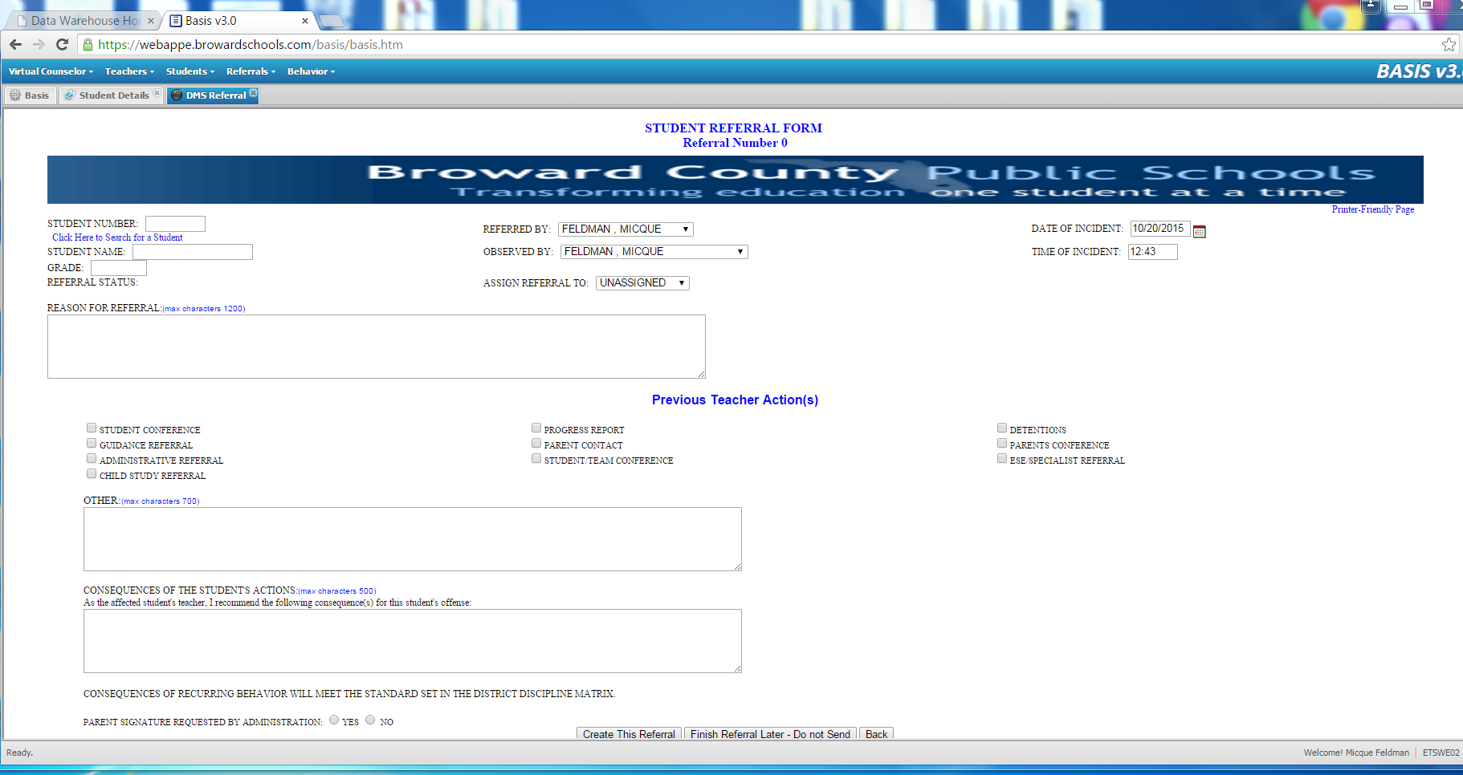
Notes:
In the referral form you will search for the student by clicking on the “Click here to search for student” verbiage in blue”.

Slide 33
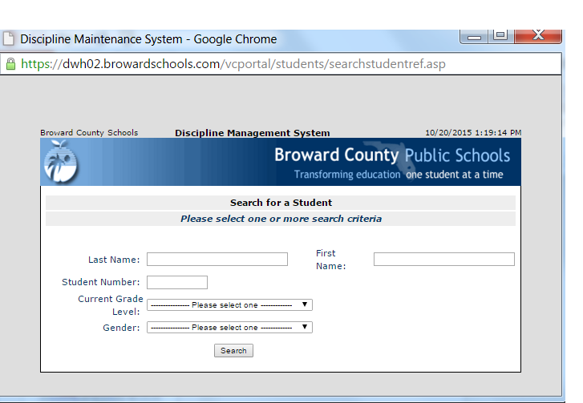
Notes:
A search for student window opens. You can search by any one of the criteria. When the student is found the information will auto populate.

Slide 34
Notes:
After the student has been located in the data base the student information will auto populate. It is important to assign the referral to an individual from the drop down menu. This ensures that the appropriate administrator will receive a notification that the referral was created. All of the important information is built into the BASIS form. Comments on this form should be specific to the incident. This is a legal document and the information you submit can be subpoenaed into court. Information should not include opinions or diagnosis- The information should be measurable and observable.

Slide 35
Effective Discipline Procedures
Developing a Coherent
Discipline Referral Process
Notes:
Once the discipline team has defined the behaviors on campus, developed consequences and determined what forms will be used, we are ready to develop a process that enables all parties to proceed with managing an incident in the same manor.
All stakeholders need to have the information necessary to equitably deal with these inappropriate behaviors. This can be achieved by creating an easily referenced flowchart which will help to maintain consistency in our school.

Slide 36
Discipline Referral Process
Effective Process
  Includes definitions, responses, & forms
  Facilitates consistency in discipline across campus
  Avoids long delays between the behavior and the disciplinary action
  Communicates with stakeholders
      Staff involved
      Families: Direct, timely notice
      Students: Reviews their responsibilities
  Establishes re-entry procedures for staff and students
  Implemented with fidelity to facilitate data-based problem-solving
Notes:
The referral process combines the behaviors as they were defined for your campus as well as the forms used to collect data and produces a process for follow up. If faculty use the process consistently, it will help suppress problem behavior. There are many ways to structure your referral process. You may choose to include procedures for minor incidents and major incidents on one flow chart. High schools and middle schools may choose to designate a team at each grade level or subject area to assist with the minor forms. It may also be appropriate to assign grade-level/subject-area problem solving teams, to encourage staff to take more ownership of a problem (to encourage use of the problem solving model). The process needs to specify how the communication loop is completed, and how to re-establish positive rapport when a student returns to a classroom. Staff need to understand the process & use it appropriately so Tier 1 Problem Solving teams have accurate data and problem identification.
Communication with stakeholders is an essential piece of the process. Teachers need to be advised of the consequence that was put in place and the outcome. Staff will not support the process if they do not feel it is working. When a classroom teacher sends a student to the office, the teacher is saying “I can’t handle it”. Classroom level problem solving should be encouraged, but teachers still need to feel supported. If the problem has truly escalated they need assistance to regain control.
Getting input from parents about the process as well as sharing the final process with them is important so that they know what to expect. Parents must be advised of the behavior and the consequence if we expect their support in changing the inappropriate behavior.
Students: reminds students of their responsibilities especially when a delay between consequence. Students need an opportunity to reflect on the inappropriate behaviors and to learn and practice what is an appropriate replacement behavior.

Slide 37
Resource: ‘Discipline Chart #1’ in Attachments
Consistently Teach and Re-Teach Tier 1 Rules/Expectations
Observe and identify problem behavior
Staff managed
Is the behavior Teacher or Administration managed?
Administration managed
Redirect student
Re-teach behavior
Conference with student on inappropriate behavior in this situation and of potential + /- consequences
Teacher/Staff vs. Administration
Managed Managed
Referring Teacher/Staff Member completes discipline referral and contacts parent
Failure to be in assigned place
Inappropriate language
Tardiness
Calling out
Teasing
Inattentive Behavior
Invading personal space
Lying/giving false information
Minor disruption
Minor aggression-grabbing items; pushing past someone
Unsafe or rough play
Misusing property-throwing or damaging items
Disrespectful Tone
Pattern of not completing homework
Aggressive physical contact
Bullying/Harassment
Fighting
Property destruction
Weapons
Leaving School property
Pattern of aggressive/profane language
Dress Code
Credible threats
Major/chronic destruction
Major/chronic refusal to follow school rules
Theft
Racial/Ethnic discrimination
Cheating
Inappropriate use of internet
Direct refusal of authority
Complete
Detention Slip and Contact Parent
Administration follows up teacher/staff member
Teacher and guidance counselor work with student to re-teach behavior and propose strategies for success
Administrative action
Did the behavior change?
YES
Administration submits referral for data input
NO
Notice and reward correct behaviors
Complete Discipline Referral and send student and referral to the discipline office
Seminole County: Longwood Elementary
Notes:
The next few slides are some examples of discipline flow charts. these are just samples and each one has positive and negative aspects. On this chart the highlighted items are some of the positives. Click 1- The chart reminds teachers to consistently teach and re-teach Rules and expectations. It also includes a step of conferencing with the student regarding the inappropriate behavior and possible positive and negative consequences. Click 2- This chart includes both teacher/staff managed behaviors as well as Administration managed behaviors within the flow chart. The definitions are clearly visible as the teacher determines in which direction to proceed. Click 3- There is also a step to notice and reward correct behaviors when they occur. This could be simplified by placing the teacher/staff managed and Administration managed sections on the back. Not as busy but still one page.

Slide 38
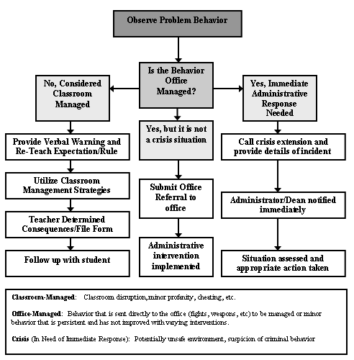
Resource: ‘Discipline chart #2’ in Attachments
Notes:
This sample added a section for crisis problems. This is a much simpler flow chart to follow. However it is expected that staff is aware of how to complete each step. This is a very basic flow chart.

Slide 39
OFFICE
IS THE INCIDENT MANAGED IN THE ...
Resource: “Discipline chart #3’ in Attachments
CLASSROOM
Behavior stops no further action
Write a referral & escort student to office
Verbal Warning
Re-state Expectation/Rule
SAMPLE INTERVENTIONS
Seating Change
Student Conference
Parent Contact
Student Contract
Redirection
Proximity
Loss of Privilege
Restitution
Apology
Verbal & Non-Verbal Prompt
Reward Alternate Behavior
2nd Step (same behavior)
Re-teach Expectation, begin classroom behavior report/apply intervention
Behavior stops no further action
Admin determines consequence
3rd Step (same behavior)
apply intervention
contact parent
Behavior stops no further action
Teacher Completes Classroom Assessment Tool (CAT) to assess variables in classroom that may be promoting problem behavior (i.e.. ecological, classroom behavior system, & curriculum/ instruction)
Behavior stops no further action
Copy of referral given to teacher/staff
Copy retained at school
Copy of referral sent to parent via student
4th Step ( same behavior)
Continue classroom behavior report. Contact a peer, guidance, or admin for further intervention/suggestions
Student conference
Re-teach expectation
Parent contact
Detention
Refer to guidance
In-school suspension
Out school suspension
Recommend for expulsion
5th Step ( same behavior)
Refer to guidance or complete office referral form
For Office Referrals attach completed copies of classroom behavior reports
Write a referral & escort student to office
Martin County Schools: Hidden Oaks MS
Notes:
The key items on this flow chart include the list of interventions provided front & center as an easy reference for teachers, and the inclusion of the Classroom Assessment Tool which will help teachers examine environmental influences on re-occurring behavior. There is also a list of potential Administration consequences. All of these pieces of information assist faculty and administration respond quickly and effectively to an incident.

Slide 40
Comprehensive Approach to Discipline
Teach & reward appropriate behavior
Engage in active supervision
Address environment, curricula, and instruction
Use pre-corrections/ prompts (verbal, visual, physical)
Prevent
Instruction tied to Tier 1 Expectations
Practice appropriate alternatives
Hierarchy of consequences (severity,
motivation)
Verbal de-escalation (CPI Institute)
Monitor effectiveness
Respond
Communication
Re-Entry Procedures
Follow-Up
Notes:
We have covered a great deal of material this morning. Let’s summarize the components of designing an effective discipline plan. When we have defined the behaviors on our campuses we can develop a process to respond effectively. Teams should realize that disciplinary actions aren’t limited to phone calls home, detention, and suspension. A comprehensive discipline plan includes strategies to help prevent problem behavior from occurring, and should also have a strong emphasis on teaching appropriate alternative behaviors. When planning responses to problem behaviors or response hierarchies, teams should include strategies that fit the characteristics of preventing & responding effectively. Follow-up or what schools do after an administrative decision can lay the groundwork for preventing additional infractions. The goal of discipline procedures is to ensure that all stakeholders are aware of the discipline process and adhere to it. Ensuring that data is being collected through the use of forms for both minor and major incidents. And that the data is used to drive decisions regarding managing behaviors.

Slide 41
Poll Questions
Notes:
I would like to close with a few pol questions.

Slide 42
Upcoming Webinars
Date | Webinar Topic
Thursday- November 19, 2015 | Data Entry/Analysis
Thursday- December 17, 2015 | Rules and Expectation
Thursday- January 21, 2016 | Reward and Recognition Programs
Thursday- February 25, 2016 | SPBP Best Practice
Thursday- March 31, 2016 | Lesson Plans for Teaching Behavior
Thursday- April 28, 2016 | Implementation Plan
Thursday- May 25, 2016 | Classroom PBIS Systems & Evaluations

Slide 43
Next Steps....
Print up RtI:B Webinar Schedule
Print up 10 Critical Elements for reference
Print up attachments to to this webinar
Complete Effective Discipline Process and Flow Chart Action Steps by 11/18 for next webinar:
Have your team join us on 11/19 for the next webinar:
Data Entry and Analysis

Slide 44


Contact information
Diversity, Prevention & Intervention
Lauderdale Manors Resource Center
754-321-1655
or visit our website at:
www.browardprevention.org

