Slide 1
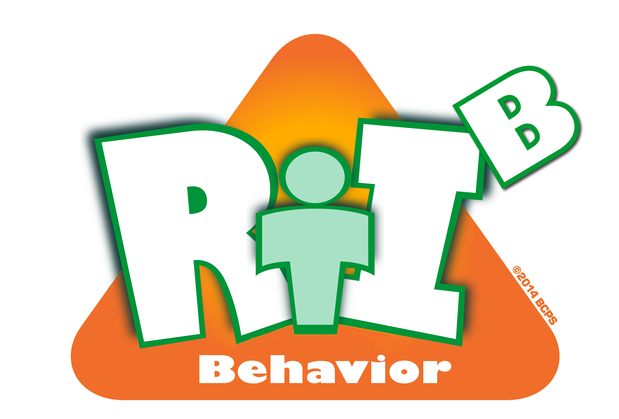
Tier 1
Response to Intervention for Behavior (RtI:B)
Addressing the Behavior of All Students

Slide 2
District RtI:B Mission Statement
Tier 1 Training Across Broward
To assist RtI:B teams in developing new, positively-oriented strategies that are grounded in research and support at-risk students while helping ALL students become more successful learners and leaders.
Notes:
This District's Mission for RtI:B is to assist school teams in developing new, positively-oriented strategies that are grounded in research and support at-risk students while helping ALL students become more successful learners and leaders. The District, along with the State of Florida’s Positive Behavior Intervention and Support or PBIS Project provides training to schools in Broward County with developing a Tier 1 Behavior Curriculum.

Slide 3
Response to Intervention for Behavior
RtI:B Webinar Series
Training Opportunity:
  To review all 10 critical elements of Tier 1
  Behavior Curriculum via monthly webinars
  Today’s Webinar:
  Critical Element #2
  Faculty Commitment
Resource: ‘Webinar Schedule’ in Attachments

Slide 4
RtI:B Tier 1 Ten Critical Elements
RtI:B Team, Administrative Support
Faculty Commitment
Effective Procedures for Discipline
Data Entry & Analysis
Expectations & Rules
Reward/Recognition Program
Lesson Plans for Teaching Behavior
Implementation Plan
Classroom PBS Systems (CHAMPs)
Evaluation
⬅
Resource: See ‘10 Critical Elements in attachments’
Notes:
As we already know there are ten critical elements that make up the Tier 1 RtI: Behavior model. Today we will take a closer look at how to gain faculty buy in with your Positive Behavior Plan you developed during the three-day tier 1 training. It is essential to gain initial faculty buy-in with your plan as well as ongoing commitment throughout years of implementation.

Slide 5
Faculty Commitment
Definition: Open and honest communication is established among stakeholders to secure buy-in commitment to change
Purpose: Prepare and plan for facilitating
implementation of Faculty Commitment
You should be able to:
Develop a plan to get 80% buy-in from faculty
Share school-wide behavior data regularly with faculty
Give faculty opportunities to provide feedback, to offer suggestions, and to make choices in your Tier 1 system
Notes:
Faculty commitment can be defined as open and honest communication that is established among stakeholders to secure buy-in commitment to change. The purpose for today’s webinar is to prepare and plan for gaining initial staff buy-in as well as maintaining at least 80% buy-in throughout the years. By the end of this presentation you should also be able to have the resources necessary to share school-wide behavior data regularly and gain ideas on how to solicit faculty feedback and and make changes in your tier 1 system.

Slide 6
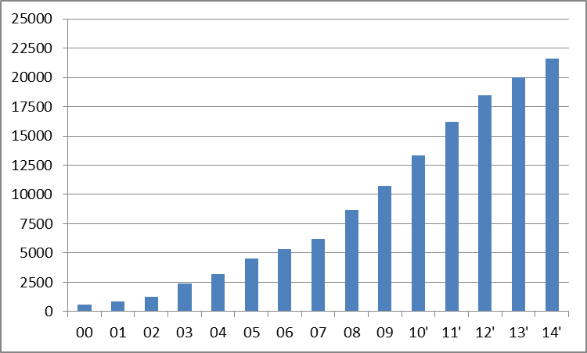
Schools using RtI:B/PBIS
August , 2014
21,611
Notes:
I would like to start by showing the growth of schools implementing RtI:B. As of August 2014, there are 21,611 schools implementing RtI:B or commonly known as Positive Behavior Intervention & Support (PBIS). As you can see this is not a new initiative, however it is one that is gaining more popularity. The number of schools adopting these positive practices continues to grow year by year.

Slide 7
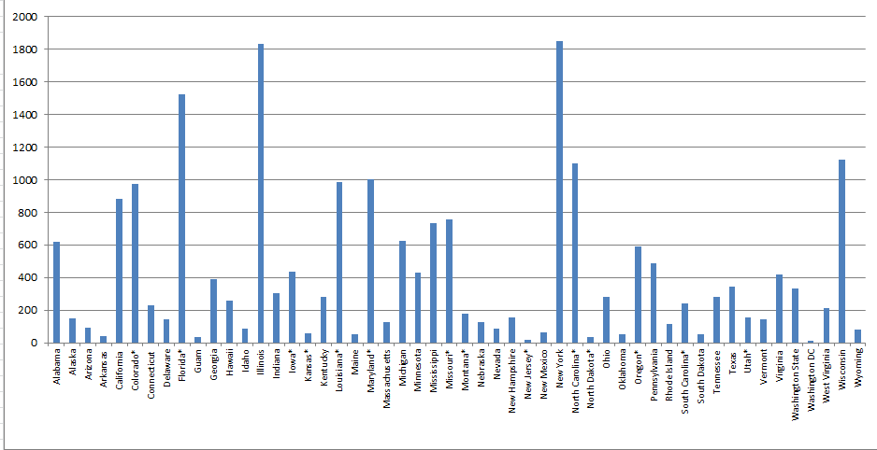
Number of Schools Implementation RtI:B/PBIS (Tier I) by State
August, 2014
14 States with more than 500 schools
Notes:
If we look at the number of school implementing RtI:B by each state, we can see that Florida is in high implementation with close to 1,500 schools who have adopted the RtI:B- Positive Behavior Intervention and Support model. Florida also being one of the 14 states with more than 500 schools trained. It is good to know that Florida is leading the change with its positive behavior practices.

Slide 8
Keys to Faculty Commitment
Initial Buy-In
  Administrative support and modeling from leadership
  Clear vision of how changes will impact people personally
  Emphasize the benefits and compelling reasons for change
  Ensure stakeholder ownership
  Teach and reward all stakeholders
On-going Commitment
  Maintaining 80% buy-in; getting new staff, students, families on board
  3-5 years for full implementation; Not a one shot deal
  Include all stakeholders at all stages
  Philosophical shift so expect some resistance
  Continue to teach and reinforce

Slide 9
Initial Buy-In
Share Main Messages of Tier 1 RtI:B/PBIS
Staff Surveys/Voting Process
Communication is essential in this process
Open communication will allow faculty to feel as though they are part of the change process
Faculty will begin to understand what is happening across campus
Frequent communication opens dialogue for problem-solving across campus

Slide 10



Main Messages
RtI:B/PBIS is a foundation for the next generation of education.
Effective (academic, behavior)
Equitable (all students succeed) Efficient (time, cost)
Notes:
You can also share the main messages of a having a school-wide RtI:B plan with staff using research and statistics. Faculty will be more likely to buy-in to a system that has proven to be effective.
RtI:B/PBIS is a foundation for the next generation of education. It is proven to be effective, equitable and efficient.

Slide 11
Experimental Research on Tier 1 RtI:B/ PBIS
Bradshaw, C.P., Koth, C.W., Thornton, L.A., & Leaf, P.J. (2009). Altering school climate through school-wide Positive Behavioral Interventions and Supports: Findings from a group-randomized effectiveness trial. Prevention Science, 10(2), 100-115
Bradshaw, C.P., Koth, C.W., Bevans, K.B., Ialongo, N., & Leaf, P.J. (2008). The impact of school-wide Positive Behavioral Interventions and Supports (PBIS) on the organizational health of elementary schools. School Psychology Quarterly, 23(4), 462-473.
Bradshaw, C. P., Mitchell, M. M., & Leaf, P. J. (2010). Examining the effects of School-Wide Positive Behavioral Interventions and Supports on student outcomes: Results from a randomized controlled effectiveness trial in elementary schools. Journal of Positive Behavior Interventions, 12, 133-148.
Bradshaw, C.P., Reinke, W. M., Brown, L. D., Bevans, K.B., & Leaf, P.J. (2008). Implementation of school-wide Positive Behavioral Interventions and Supports (PBIS) in elementary schools: Observations from a randomized trial. Education & Treatment of Children, 31, 1-26.
Bradshaw, C., Waasdorp, T., Leaf. P., (2012 )Effects of School-wide positive behavioral interventions and supports on child behavior problems and adjustment. Pediatrics, 130(5) 1136-1145.
Horner, R., Sugai, G., Smolkowski, K., Eber, L., Nakasato, J., Todd, A., & Esperanza, J., (2009). A randomized, wait-list controlled effectiveness trial assessing school-wide positive behavior support in elementary schools. Journal of Positive Behavior Interventions, 11, 133-145.
Horner, R. H., Sugai, G., & Anderson, C. M. (2010). Examining the evidence base for school-wide positive behavior support. Focus on Exceptionality, 42(8), 1-14.
Ross, S. W., Endrulat, N. R., & Horner, R. H. (2012). Adult outcomes of school-wide positive behavior support.
Journal of Positive Behavioral Interventions. 14(2) 118-128.
Waasdorp, T., Bradshaw, C., & Leaf , P., (2012) The Impact of Schoolwide Positive Behavioral Interventions and
Supports on Bullying and Peer Rejection: A Randomized Controlled Effectiveness Trial. Archive of
Pediatric Adolescent Medicine. 2012;166(2):149-156
Bradshaw, C. P., Pas, E. T., Goldweber, A., Rosenberg, M., & Leaf, P. (2012). Integrating schoolwide Positive Behavioral Interventions and
Supports with tier 2 coaching to student support teams: The PBISplus Model. Advances in School Mental Health Promotion, 5(3),
177-193. doi:10.1080/1754730x.2012.707429
Freeman, J., Simonsen, B., McCoach D.B., Sugai, G., Lombardi, A., & Horner, ( submitted) Implementation Effects of School-wide
Positive Behavior Interventions and Supports on Academic, Attendance, and Behavior Outcomes in High Schools.
School-Wide PBIS Experimentally Related to:
Reduction in problem behavior
Increased academic performance
Increased attendance
Improved perception of safety
Reduction in bullying behaviors
Improved organizational efficiency
Reduction in staff turnover
Increased perception of teacher efficacy
Improved Social Emotional competence
Notes:
This slide shows the research behind the effectiveness of this system. Research proves that implementing Tier 1 Positive Behavior Intervention and Support directly impacts the following:
Reduction in problem behavior
Increased academic performance
Increased attendance
Improved perception of safety
Reduction in bullying behaviors
Improved organizational efficiency
Reduction in staff turnover
Increased perception of teacher efficacy
Improved Social Emotional competence

Slide 12
Culturally Equitable Academic &
Social Competence
School-wide RtI:B/PBIS
OUTCOMES
Culturally Valid
Decision
Making
Culturally Relevant
Support for
Student
Behavior
DATA
PRACTICES
SYSTEMS
Culturally Knowledgeable
Staff Behavior
Notes:
This system is also proven to be equitable, since Tier 1 RtI:B address the behavior needs of ALL students.
SWPBS: Four Elements
RtI:B builds from a focus on student Outcomes: academic achievement, social competence, and safety.
RtI:B “Practices” are the behaviors of adults that affect how students perform. These are the daily, classroom, and on-going discipline practices of the school
RtI:B “Systems” are the organizational decisions and structures that support effective STAFF Behavior. A major strength of SWPBS is the emphasis on practices delivered WITH the systems needed to support the practices; and
The use of data for decision-making is the single most important system within SWPBS. This element is used both to ensure the SWPBS practices are tailored to the local context/culture, and to benefit the continuous regeneration needed for sustained implementation.

Slide 13
Time Cost of a
Discipline Referral
 | 1000 Referrals/yr | 2000 Referrals/yr
Administrator Time | 500 Hours | 1000 Hours
Teacher Time | 250 Hours | 500 Hours
Student Time | 750 Hours | 1500 Hours
Totals | 1500 Hours | 3000 Hours

Slide 14
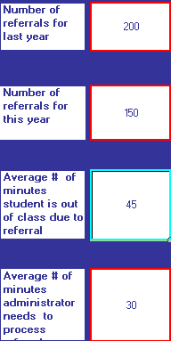
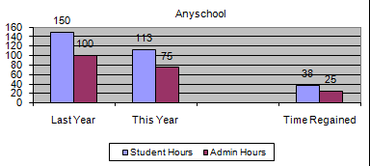
Time Regained with RtI:B/PBIS
http://www.pbismaryland.org .... “Cost/Benefit Worksheet”

Slide 15
Strategies for Faculty Commitment
Skits, videos, role-plays
Create a Teacher Tool Kit
Surveys (students, families, staff)
    Obtain feedback
    Create involvement without holding more meetings
    Generates new ideas
    Build a sense of “whole school” ownership
    Share results quickly and frequently
Reward Staff
Share the data
    Survey results
    Visuals are a powerful tool
    Progress reporting
Notes:
Here are just some suggested ways to get faculty buy-in. Skits, videos, role-plays, create a teacher tool kit, survey stakeholders, reward the staff and of course, share the data.
The next few slides will give explain some of the ideas mentioned.

Slide 16
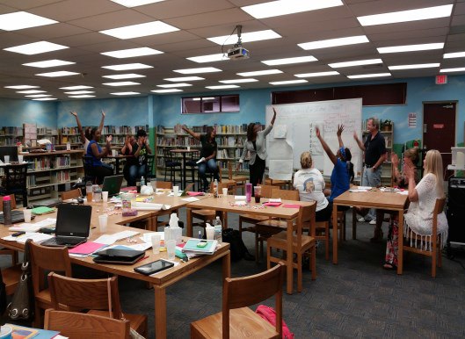
Make it FUN!
Skits
Games
Role Plays
Collaboration
Activities
Show RtI:B Videos- Access from Drop Box link
https://www.dropbox.com/sh/zorjx1gt9qoj5al/AAAVSvMY0gSV31m7y_eHcnj6a?dl=0
Resource: ‘RtI:B Videos’ in attachments
Photo Credit: Margate Middle School
Notes:
Skits, videos, role-plays are good ways to gain buy-in in a fun way. Show funny video clips to get your point across during trainings. Videos shown in the RtI:B Tier 1 training are located in a drop box account. Use the link provided for access. Also, make sure to download the ‘RtI:B Video Sheet’ in attachments for an explanation of each video and how it relates to each topic.
https://www.dropbox.com/sh/zorjx1gt9qoj5al/AAAVSvMY0gSV31m7y_eHcnj6a?dl=0

Slide 17
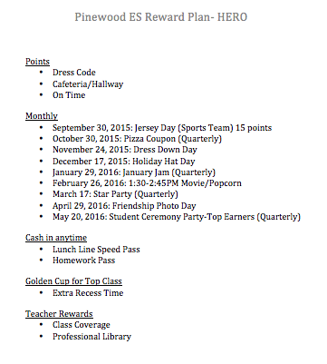

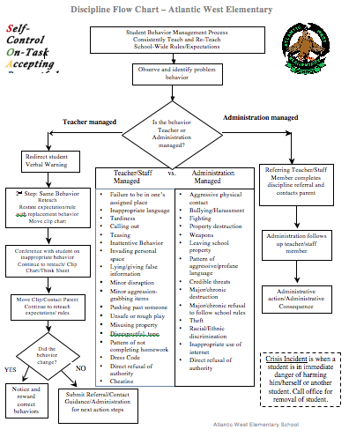
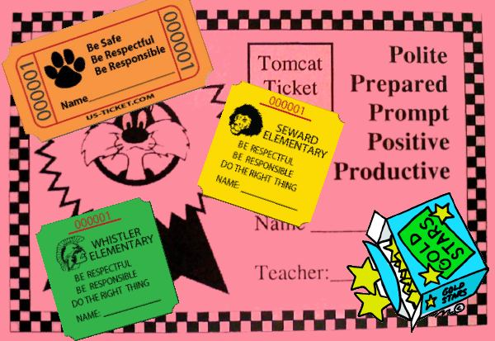
Teacher Tool Kit
Notes:
Once the plan have been agreed upon by staff, teams can create a teacher tool kit to give out including items such as a poster of the school-wide expectations, discipline flow chart, reward coupons, incentives, etc. If teams make the plan easy for teachers to follow, they are more likely to have better results with teacher usage. Teachers will appreciate teams giving out a variety of resources to use in their classrooms to support the school’s mission.

Slide 18
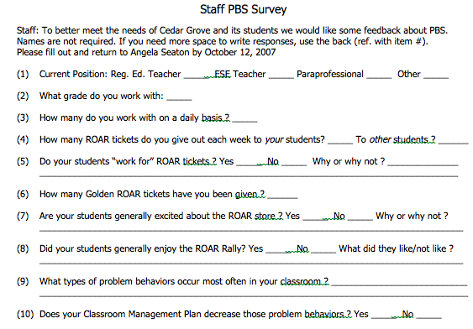
Survey Says…
Go Digital
Poll Everywhere
  www.pollev.com
Easy Polls
  https://www.easypolls.net/
Survey Monkey
  https://www.surveymonkey.com/
For more example surveys go to
http://flpbs.fmhi.usf.edu/evaluations.cfm

Slide 19
Sample Staff Survey Questions
What behavior would you most like to see in students?
What do you think is the top behavior problem on campus?
How do you typically respond to:
    Problem behavior?
    Appropriate behavior?
How many referrals did our school have last year?
How much time did our school lose to discipline issues?
How do you feel at the end of the day?
What are the 3 top locations where problem behavior occurs?
Notes:
19
These are some sample staff survey questions for beginning implementers. These kinds of questions will help faculty see what common behavior problems exist across campus (not just within their own classroom), and help teams get ideas to build consensus & prioritize activities. If you use a survey be sure that in the next meeting you let staff know that their input is being recognized and acknowledged.

Slide 20
Staff Survey Feedback
CONCERNS about PBIS
Not enough serious consequences for students’ actions (8)
Teachers do not know when a referral has been addressed.(5)
Infractions were not taken seriously by students (3)
School reward store should be held more frequently (12)
CHANGES Implemented
Administration is aware of concerns and will review hierarchy of consequences.
Establish a system to improve communication with teachers through email.
AP will follow-up when parent contact is unsuccessful.
Reward store will be open monthly. Scheduled in advance and marked on calendar (every 4 weeks)

Slide 21
A Job Well Done!
Develop system for rewarding staff
Ideas for cost effective rewards
  Late Pass to work
  Early Dismissal from work
  RtI:B Golden Cup for the Month
  VIP Parking
  Recognition in Newsletter or Morning Announcements
  Marzano Ratings
    Domain 4 (Collegiality and Professionalism; Promoting a Positive Environment) for (#15) Promoting Positive Interactions about Students and Parents.
  Teacher Appreciation Week
  Coffee Break Class Coverage
  Monetary Rewards (Gift Cards, School Supplies)
  Lunch on us- lunch provided to top teachers

Slide 22
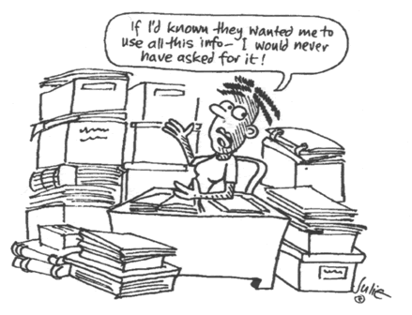
Data need not be a four-letter word
Notes:
Sharing ongoing behavior data will help to maintain faculty commitment through the years of implementation. We are constantly gathering data but are we sharing the findings with the appropriate staff? Often times teachers do not have a school-wide view of behavior and discipline like administration and support staff do. They might not be aware of the behavior problems across the campus or that the system there are using is actually showing positive results. Let the staff know that all their hard work is paying off, they are more likely to continue putting in the effort.

Slide 23
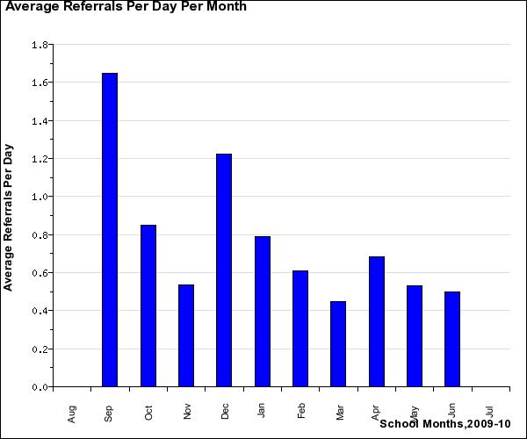
Average Referrals Per Day Per Month
Notes:
Here are some examples of Tier 1 behavior data you can collect and show to staff. This graph shows the average amount of discipline referrals per day per month. Looking at this graph, I can see that the highest number of discipline referrals was in September and December. Using the data a team could put a plan into place to focus on teaching school-wide expectations during these months as well as utilizing a highly enthusiastic reward for students earning positive behavior points.

Slide 24
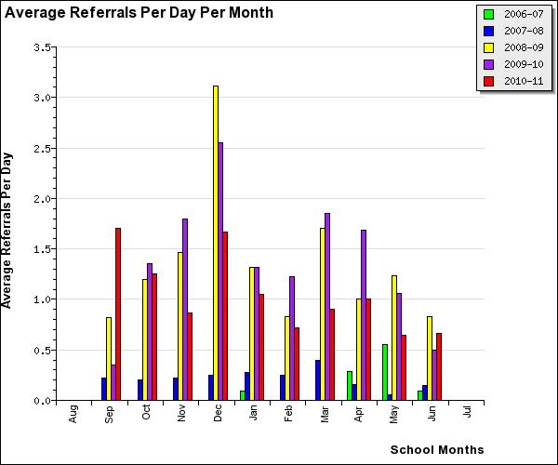
Multi Year Office Referrals per Day Per Month
Notes:
This is another example of how you can provide data to your faculty. This graph displays the amount of discipline referrals per day per month over multiple years. Teams will want to include the year before implementation as baseline data and then show the years when you began implementation. This can prove to faculty that there efforts with the school-wide plan is worthwhile and is making a difference.

Slide 25
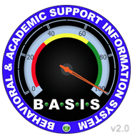
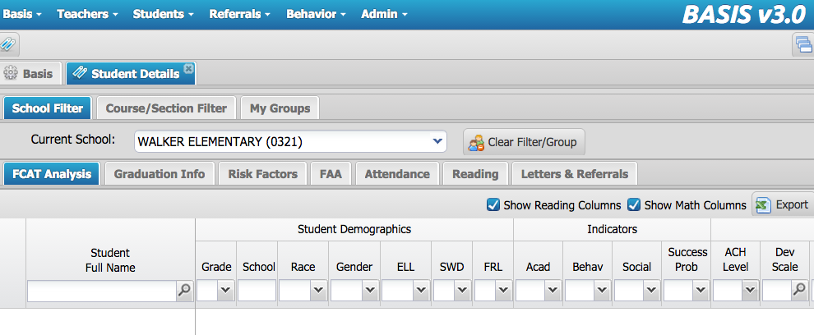
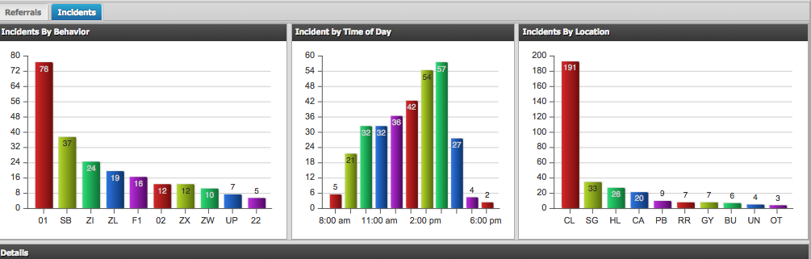
BASIS 3.0
Behavior Dashboard
Notes:
BASIS 3.0 allows you to gather behavior data in an efficient way. Once logged into to BASIS 3.0, locate “Behavior” in the navigation bar at the top of the page. Then click on “Behavior Dashboard” from the dropdown. This page will disseminate your referral data in a variety of ways. You can view your top ten behavior incidents and the top locations where referrals are written. This is important data to collect as this data will assist you in creating your School-wide Positive Behavior Plan (SPBP). You may also view the discipline referrals by race, grade, event, and teacher.

Slide 26
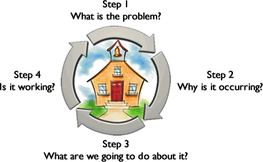
Problem Identification
Progress Monitor
Problem Analysis
Intervention Design
Notes:
After collecting tier 1 behavior data, it is important that we return to the Problem Solving Process to analyze the findings and put an intervention into place to support positive behavioral outcomes. You can let staff know that according to the data findings, changes may need to be made in order to solve these problems.

Slide 27
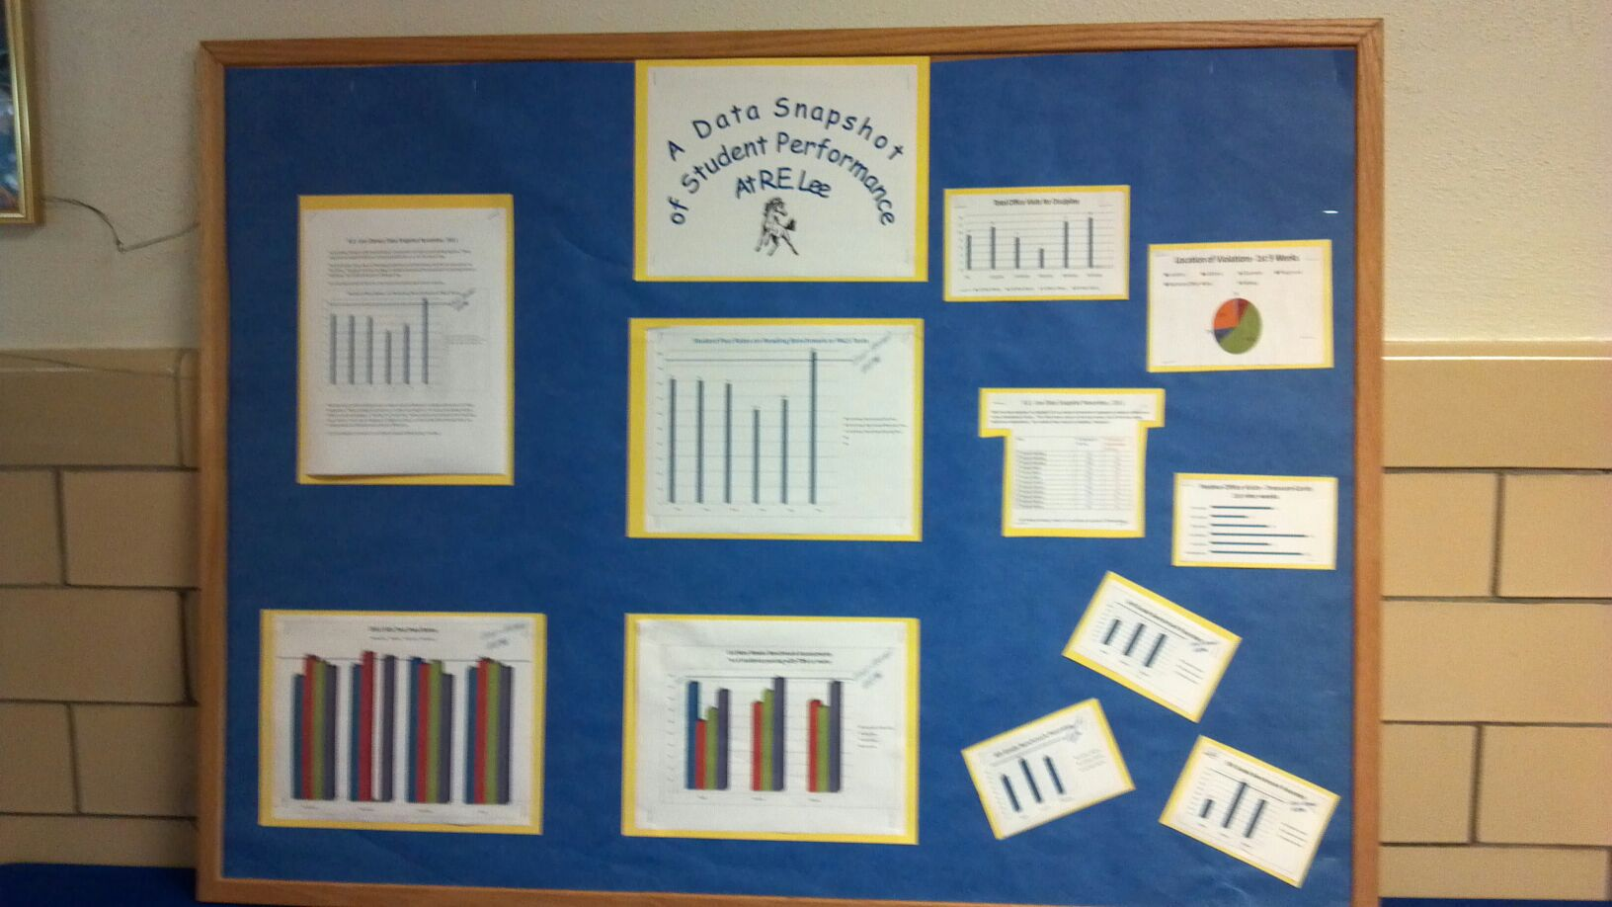
How will you showcase results?
Share visuals with staff monthly
  CAB Conference
  Teacher’s Lounge
  At Faculty Meetings
  Faculty Newsletter
What’s working?
What needs more focus?
Emphasize staff involvement
Notes:
Share visuals with staff monthly via CAB conference, in the teacher’s lounge, at faculty meetings or in a newsletter. Find out what works best at your school.
You will also want to showcase What’s working? What needs more focus? And Emphasize staff involvement!

Slide 28
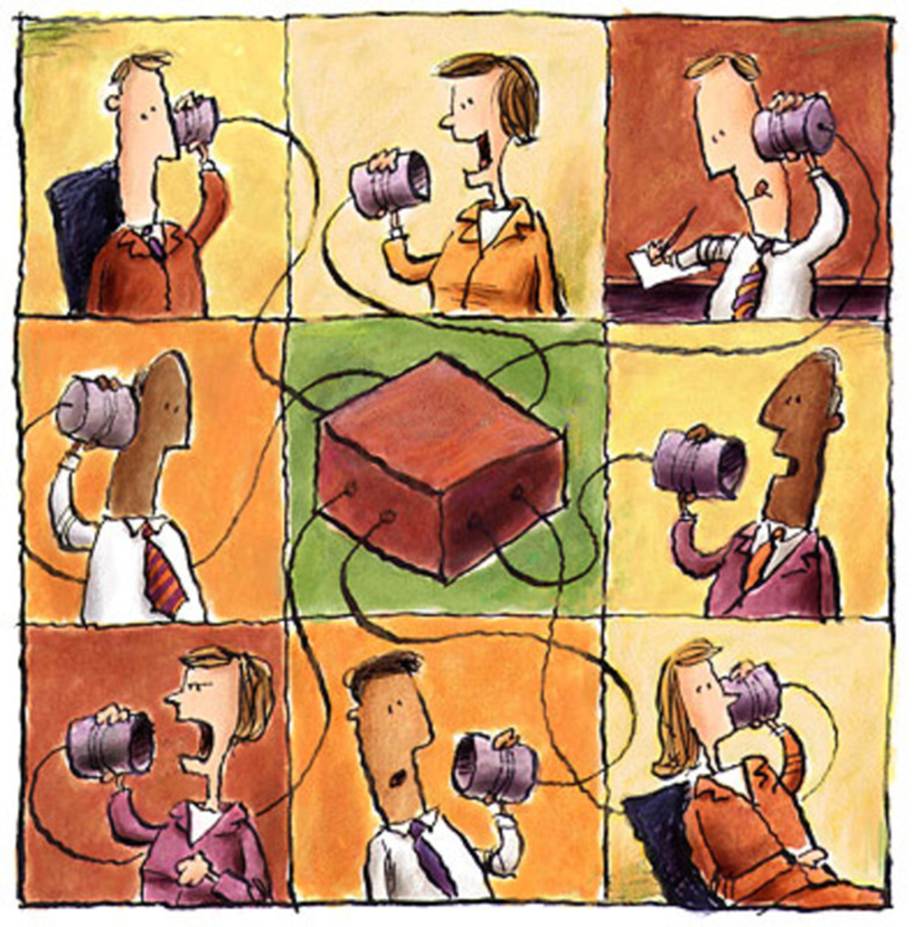
Create a Communication System
For…
Sharing ongoing information
Presenting data
Obtaining feedback from stakeholders
Reviewing goals and action plans
Notes:
Create a commination system that gets the information to all stakeholders in a quick, easy way. This communication system should allow for stakeholders to provide feedback and the team to review the goals and plan.

Slide 29
Communication and Feedback Loops
Grade level/core/department meetings
Vertical team meetings
Staff/Faculty Meetings
Google Docs, SharePoint, or other virtual sharing mechanisms
Newsletters
Professional development days
Communities of Learners (PLCs)
Notes:
Here are some already existing ways we communicate in our schools. Think about what communication system(s) already work at your school and how we can tie RtI:B into an already exiting initiative.

Slide 30

How will you engage staff in the implementation of Tier 1 RtI:B?
Please type your response in the chat box
Notes:
Now that we discussed many strategies for gaining faculty commitment, How will you engage staff in the implementation of Tier 1 RtI:B? Please type your responses into the chat box.

Slide 31
Change is Individual
Change is a process, not an event.
Systemic change begins at the individual level. When the majority of individuals have changed, the system has changed.
Change is a personal experience
Individuals change at different rates and in different ways.
Individuals must change in to two important ways knowledge and beliefs
Supports must be provided at an individual level
(Fullan, 1985; Hall & Hord, 2006) (Feuerborn, 2011)
Notes:
Here are some things to remember when you begin to roll out your system with faculty. Change is individual. Do not expect to have 100% buy-in right away. It takes time. Don’t give up, as your Tier 1 system improves, so will the faculty commitment.

Slide 32
Implementation Stages
Implementation occurs in stages:
Exploration
Installation
Initial Implementation
Full Implementation
2 – 3 Years
Fixsen, Naoom, Blase, Friedman, & Wallace, 2005

Slide 33
Stages of Implementation
Steve Goodman
Focus | Stage | Description
 | Exploration/ Adoption | Decision regarding commitment to adopting the program/practices and supporting successful implementation.
 | Installation | Set up infrastructure so that successful implementation can take place and be supported. Establish team and data systems, conduct audit, develop plan.
 | Initial Implementation | Try out the practices, work out details, learn and improve before expanding to other contexts.
 | Full Implementation | Expand the program/practices to other locations, individuals, times- adjust from learning in initial implementation.
 | Continuous Improvement/ Regeneration | Make it easier, more efficient. Embed within current practices.
Should we do it!
Work to do it right!
Work to do it better!
Notes:
Implementation is not an event and this chart outlines each stage. This is something that would also be beneficial to share with staff. It is always a good idea to keep them in the loop on how this is a major process and is not an initiative that will come and go within a year. Rather it is mission-oriented process involving multiple decisions, actions, and corrections.

Slide 34
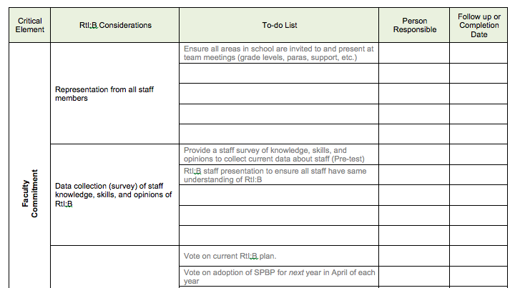
Action Plan
Resource: ‘Faculty Action Plan’ in attachments
Notes:
In the attachments you will find recommended action plan for gaining faculty commitment. Use this action plan with your RtI:B team to keep you organized and on task with this element.
Before we wrap today’s session up, I will be posting a few more poll questions for you to answer.

Slide 35
Upcoming Webinars
Date | Webinar Topic
Thursday- October 29, 2015 | Effective Discipline Procedures and Flow Chart
Thursday- November 19, 2015 | Data Entry/Analysis
Thursday- December 17, 2015 | Rules and Expectation
Thursday- January 21, 2016 | Reward and Recognition Programs
Thursday- February 25, 2016 | SPBP Best Practice
Thursday- March 31, 2016 | Lesson Plans for Teaching Behavior
Thursday- April 28, 2016 | Implementation Plan
Thursday- May 25, 2016 | Classroom PBIS Systems & Evaluations

Slide 36
Next Steps....
Print up RtI:B Webinar Schedule
Print up 10 Critical Elements for reference
Read the September RtI:B Newsletter
Print up Faculty Action Plan Guide to document action steps
Complete Faculty Commitment Action Steps by 10/29/15 for next webinar: Effective Discipline Procedures and Flow Chart
Have your team join us on 10/29/15!!!
Questions???
Please type questions into the chat box.

Slide 37


Contact information
Diversity, Prevention & Intervention
Lauderdale Manors Resource Center
754-321-1655
or visit our website at:
www.browardprevention.org

