Slide 1
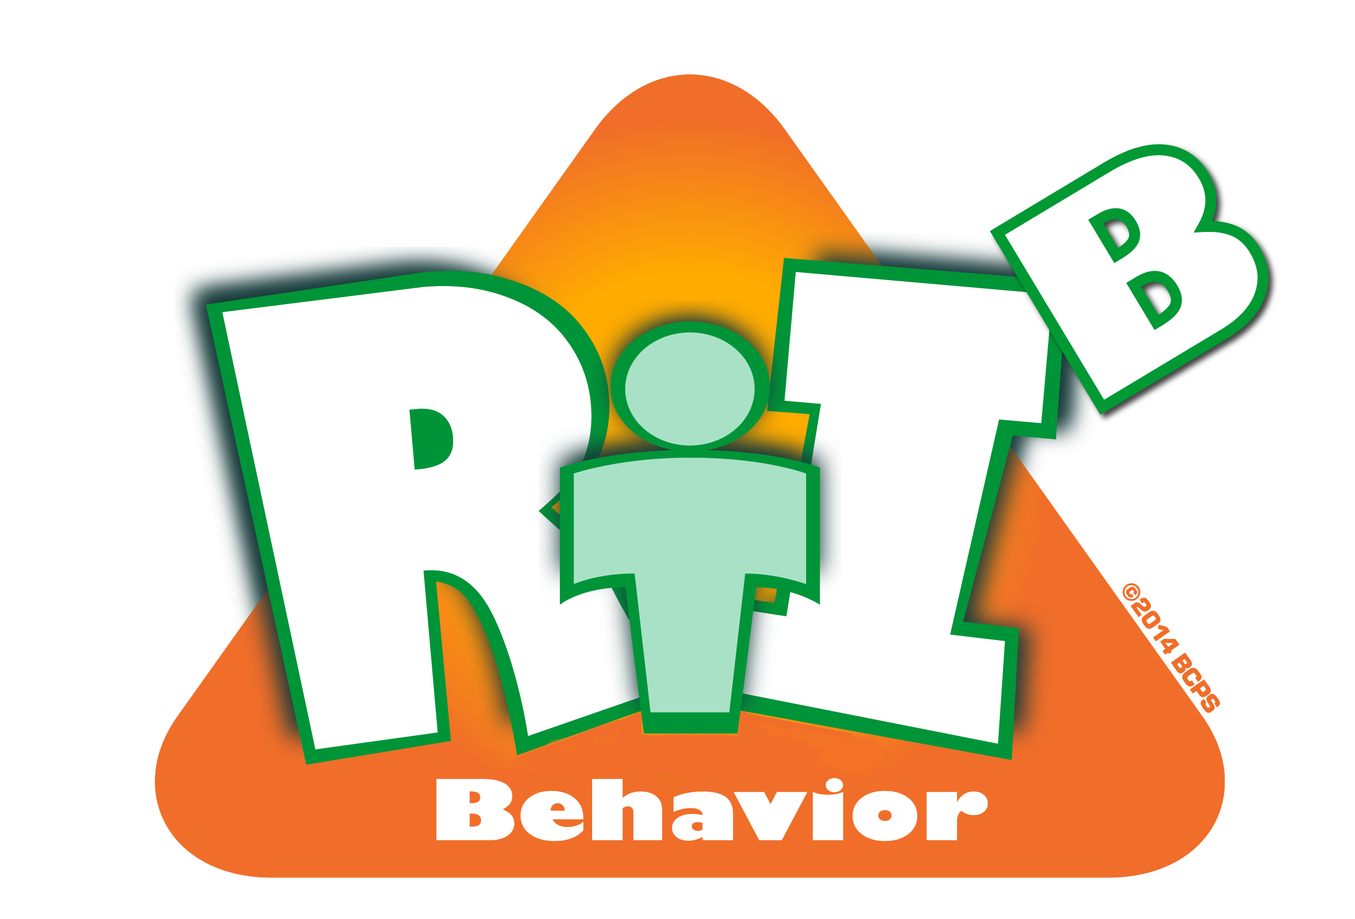
Tier 1
Response to Intervention for Behavior (RtI:B)
Addressing the Behavior of All Students
Notes:
Hello and thank you for joining us today. You have logged onto the webinar Tier 1 Response to Intervention for Behavior, or commonly known as RtI:BTier 1 RtI:B focuses on addressing the behavior needs of ALL students.
I am Georeane Nigro, one of the instructional facilitators with the Department of Diversity, Prevention and Intervention.
I am joined today by Tyyne Hogan, District Coordinator of RtI for Behavior and Micque Feldman, instructional facilitator.
If you have any questions throughout today’s webinar, please type them into the chat box and we will have a question and answer sessions at the end.

Slide 2
District RtI:B Mission Statement
Tier 1 Training Across Broward
To assist RtI:B teams in developing new, positively-oriented strategies that are grounded in research and support at-risk students while helping ALL students become more successful learners and leaders.
Notes:
This District's Mission for RtI:B is to assist school teams in developing new, positively-oriented strategies that are grounded in research that provide
support for at-risk students while helping ALL students become more successful learners and leaders. The District, along with the State of Florida’s Positive Behavior Intervention and Support or PBIS Project provides training to schools in Broward County with developing a Tier 1 Behavior Curriculum for all the students and staff at your school.

Slide 3
Developing a System for Teaching
Appropriate Behavior
Section Goals
Understand the rationale and guidelines for teaching behavior
Start outlining a plan for teaching core behavior curriculum
Provide unique resources for teaching lesson plans
Notes:
Today’s presentation will focus on Developing a System for Teaching Appropriate Behavior. With SPBPs due right around the corner, I hope you will find the information in today’s webinar valid and informative and you come away with some concrete plans that you can begin to put into place.
Our purpose today is to:
First, help you understand the rationale and guidelines for teaching behavior and .
SECOND, Start outlining a plan for teaching core behavior curriculum.
With SPBPs due right around the corner, the information presented in this webinar will hopefully help you in _________.
Before we start with the presentation, I want to get acquainted with each of you and your backgrounds and to ask a few initial questions.

Slide 4
Critical Elements of Effective RtI:B
1. Functioning RtI:B/Discipline Team
2. Faculty & stakeholder buy-in & commitment
3. School-wide Expectations with Lesson Plans
4. Location-based Rules with Lesson Plans
5. Effective Discipline Process and Procedures
6. Effective Reward/Recognition Program
7. Implementation Planning
8. Established SPBP Data-based decision making
9. Classroom Management System (CHAMPs)
10. Ongoing Progress Monitoring & Evaluation
Notes:
There are 10 critical components of RtI:B. Our present SPBP already covers some of these components and it will expand over the next 3 years to include all of the Critical Elements.
Currently, our SPBP defines a functioning RtI:B or Discipline Team and specifies required members.
The SPBP focuses on developing School-wide Expectations and Rules and the creation of concrete lesson plans for teachers. **Today we will focus on elements 3 and 4. In (month) Valerie Blackwell’s webinar focused on Expectations and rules, today I will expand on that to include lesson plans for teaching those expectations and rules. ***
We continue to look at progress monitoring and evaluation of the plan
This year we are adding components of “effective faculty buy in” and “Discipline Processes”.
Our new Behavior Dashboard in BASIS 3.0 is up and running and this will be where we get all of our behavior data from
Next year, we will expand Discipline, add Reward Procedures, and operationalize Implementation Planning.
Of course, all of this occurs concurrently with the implementation of a strong Tier 1 Classroom management system.

Slide 5

“If a child doesn’t know how to read, we teach.”
“If a child doesn’t know how to swim, we teach.”
“If a child doesn’t know how to multiply, we teach.”
“If a child doesn’t know how to drive, we teach.”
“If a child doesn’t know how to behave,
we…teach or …punish?”
“Why can’t we finish the last sentence as automatically as we do the others?”
(Herner, 1998)
Notes:
The attitude shift to get faculty on board w/ teaching behavioral skills can be challenging. The next few slides will cover some of the rationale for teaching, and provide some ammunition for common objections.
**** Perhaps use Tyyne’s behavior cartoon here instead of this slide.

Slide 6
Teaching Behavior
Cultural Differences
    Staff and families
    School and home context
    Need to teach “code switching”
Fear of Academic Failure
    May drive students to avoid stressful situations
    Need to identify appropriate alternative behaviors to be taught
Time Out of Classroom
    Negatively impacts student academic engaged time
    Skiba, R. & Peterson, R. (2003). Teaching the Social Curriculum: School Discipline as Instruction. Preventing School Failure, 47(2), 66-73.
      FLPBS Website, Resources, Research
Notes:
Perhaps combine the next three slides and talk about how the critical element (CE) __ Addresses this in detail. Just a few slides on the rationale for teaching behavior before we move onto the creating and teaching of lesson plans information.
**The bullets address the common question we hear of “Why do we need to teach behavior?” (this is one of the common concerns or complaints heard, especially at the secondary level); this slide can help teams respond teacher’s questions of why do we need to teach behavior.
Students are bombarded with examples of inappropriate behaviors that pay off for the person engaging in them. Kids are coming to school w/ maladaptive behavior patterns, and in addition they may be highly motivated to escape the classroom environment no matter what the cost. If we want to increase academic engaged time, we need to make a proactive investment in teaching appropriate behaviors.
Code switching. Teaching students that there are times and situations where their behavior may need to change. For example, basketball rules. There are basketball rules for school and then there are rules for the basketball court in the neighborhood. You would NEVER play by the basketball rules for school on the neighborhood ball court. Staff-your behavior is different in school then a weekend backyard BBQ with your friends.

Slide 7
Reasons for Teaching Behavior
Problem Behavior
    Skill deficit
    Performance deficit
    Skills are not taught in context
    Skills are not consistently rewarded and encouraged
To learn a new behavior, it needs to be repeated an average of 8 times
To unlearn an old behavior and replace it with a new behavior, it must be repeated an average of 28 times
- Harry Wong
Notes:
This slide can help teams address comments such as “They should know how to behave by now” (another common complaint heard, especially at the secondary level)
Relate back to academics. If the student is struggling academically we ask ourselves if is it a skill deficit or performance deficit, the same is for behavior? After we teach an academic skill (i.e. multiplication) we provide the student the opportunity to practice the skills with feedback and correction if needed, we are asking the same thing to be done with behavior.
******Skill Deficit
“Don’t have”
Performance Deficit
“Don’t know when to use it”
“Are not fluent with it”
“Don’t use it in all settings”
Pre-requisite for Academics
Instructional Strategies may require social skills
****Important to make that compelling why of doing a tier 1 for behavior. When it comes to actually teaching behav: skill deficit. Perfomance= they have skills but the don’t know when to use it; they aren’t fluent and its not generalized in all settings. A lot of our social skills and behavor we want to see our students demonstrate is really a prerequisite for some of the instructional strategies that were using ie small groups and cooperatve learning. The social skills that go into that are prerequisites for doing that instructional strategy well

Slide 8
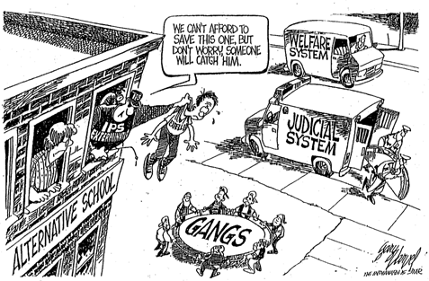
Everyone’s Responsibility
Expectations support the school’s mission statement
Proactive discipline improves school & classroom climate
Notes:
“That’s their parents’ job” addresses this complaint that is heard
Make the point that discipline means “to teach.” Might as well teach in a more pleasant environment.
The cartoon will appear automatically…it’s a little off-topic, but speaks to the point about teachers passing the buck for teaching behavior…if we don’t teach them, what will their outcomes be

Slide 9
“Social Skills are those behaviors which, within a given situation, predict important social outcomes.”
(Gresham, 1986, p. 5)
Notes:
Here is a great quote that explains the compelling why. Read quote. We want to always keep that in mind. Its not enough that we just go over the expectations the first couple of days of school. We need to consistently be teaching behavior. And teaching is one of the ten critical elements and without that piece, PBIS (your tier 1 behavior plan) will not be successful

Slide 10
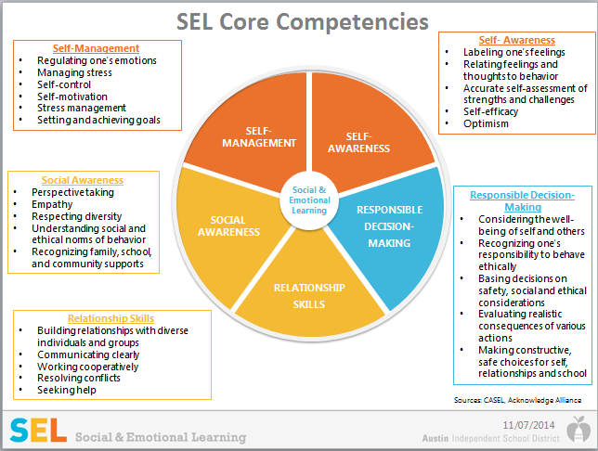
Social Emotional Learning
Notes:
Speaking of Social Skills, Broward County has 5 competencies for social and emotional learning that include: self management, self awareness social awareness relationship skills and responsivle decision making. These competencis provide the structure and process for studentsand adults to develop fundamental emotional and social competencies and experiences to:
understand and manage emotions
set and achieve positive goals
feel and show empathy for others
establish and maintain positive relationships
make responsible decisions
Builds and deepens positive school climate
5 SEL Competency
Self Management
Self Awareness
Social Awareness
Relationship Skills
Responsible Decision Making
Increased Academic Outcomes Documented!
Social-emotional skills led to improved attitudes about self, others, and school and an 11 % point gain on standardized achievement tests!
Reduced Risk of Failure Documented! Social Emotional Skills led to decrease in conduct problems and emotional distress!
DANNY NOTES:
Transition into how we can apply this information to really make a difference at our schools.
Quote from Amalio about the power of community. Teamwork.
Honor Amalio for his new position as the Assistant Superintendent of SEL in Boston Schools, and acknowledge his great work in helping Broward bring SEL to this point. Thank you Amalio.
Now it's time to put the pieces together.
SEL is not something extra.
Research shows that SEL supports every goal we have for students
1. Academic
2. Career and College Readiness
3. Personal Growth
When our students are struggling within themselves and don't have the skills to turn it around, they will have difficulty being successful
When our students don't have a caring community where they belong, they will have trouble learning.
But when student have SEL skills such as Self-awareness, Self-mamagement, Social Awareness, Relationship Skills, and Responsible Decision-making—they will succeed!
SEL also fits into our MTSS model. We need strong SEL cultures at our schools at Tier 1, and effective SEL interventions for students who are struggling at Tiers 2 and 3.
Approximately one in five students has a diagnosable disorder or mental health problem
Despite being common problems experienced by students, internalizing behavior problems are more likely to go unnoticed by educators. Schools lack systems for providing comprehensive, coordinated social and emotional supports within a prevention framework.

Slide 11
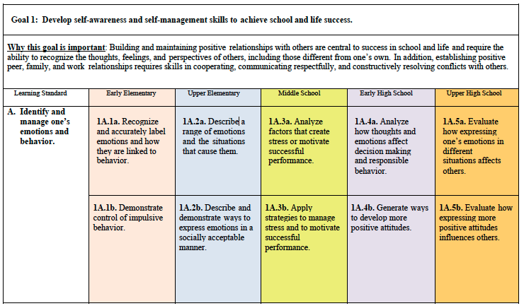
Notes:
BCPS SEL standards describe the content and skills for students in grades K - 12 for social and emotional learning. Each standard includes learning standards that describe what students should know and be able to do in early elementary (grades K - 3), upper elementary (grades 4 - 5), middle school (grades 6-8), early high school (grades 9-10), and upper high school (grades 11-12).
The standards have three (3) overarching goals:
Goal 1 - Develop self-awareness and self-management skills to achieve school and life success.
Goal 2 - Use social-awareness and interpersonal skills to establish and maintain positive relationships.
Goal 3 - Demonstrate decision-making skills and responsible behaviors in personal, school, and community contexts
You can find a copy of these standards in the attachments tab.
Refer to the Wikispace (MTSS/RtI Wiki Link: http://mtss.pds-hrd.wikispaces.net) the following resources, SEL Standards, SEL Leadership Effective Practices, SEL Teacher Practices, SEL Competencies and Learning Skills, SEL Adult Personal Assessment and Reflection, and all other materials from meeting.

Slide 12
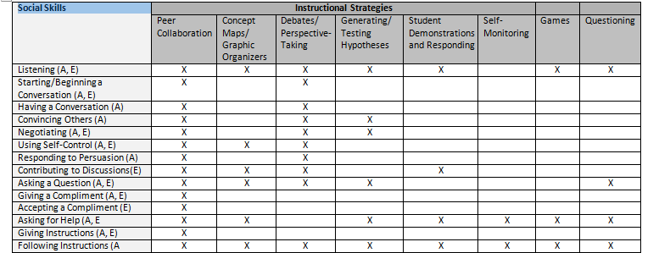
Pre-Requisite for Academics
Notes:
PBIS developed chart. This slide also helps answer the compelling why for teaching behavior to students. Across the top are some evidence-based instructional strategies that we often use in the classroom. Looking down the left hand side are a list of social skills. These social skills need to have been mastered in order to really be successful and get all you can out of the instructional strategies. Give example of strategy and social skils needed. For example, for students to generate concept maps and utilize graphic organizers they need the social skills of listening, using self control, ….etc. Ie. something as simple as asking a question is sometimes difficult because students don’t know when to ask or how to ask appropriately. Some become very good at trying to hide or compensate for what they don’t know. These are all social skills and behaviors we want our students to master so they can be successful in the classroom.

Slide 13
Developing the Core Curriculum
Ideal Student Activity
Brainstorm a list of specific behaviors of an ideal student.
    What does an ideal student do?
    What specific behaviors are exhibited?
    What engagement, social, and emotional behaviors do students need to demonstrate to be successful?
Examples – The student…
  takes responsibility for his/her behavior
  offers support to peers
  speaks out if others are bullied
  asks for help with an assignment
Explore Current Curricula Lesson Plans
    Skillstreaming, Cloud 9, Second Step, LEAPS, etc.
Lesson Plans Online
    Character Counts: Align 6 pillars with Tier 1 Expectations
      http://charactercounts.org/lesson-plans/index.html
    Florida’s PBIS website
      http://flpbs.fmhi.usf.edu/teaching_lesson_plans.asp
Customize Lesson Plans
    ‘Ideal Student’ Activity
    Involve students, families, community
Make lessons easy for staff to use
    Provide initial lessons, incentives for additional ideas
Include family engagement strategies in lessons
Notes:
Explain that if they’re using existing curricula, they need to identify how their Tier 1 expectations will be incorporated into each lesson.
Point out that the 2 links are just a couple of starting points…”Google” ‘lesson plans for Respect’ or something similar, they will get lots of results.
#3 a-Ideal student activity-perhaps put this back in and do the activity here. Ask participants to (put in previous slide) list the

Slide 14


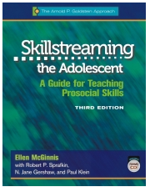
Skillstreaming
Notes:
Skillstreaming is a highly acclaimed, research-based prosocial skills training program published by Research Press. Author Arnold P. Goldstein
Skillstreaming employs a four-part training approach—modeling, role-playing, performance feedback, and generalization—to teach essential prosocial skills to children and adolescents. Each book provides a complete description of the Skillstreaming program, with instructions for teaching a wide variety of prosocial skills and a CD including reproducible forms and handouts.

Slide 15
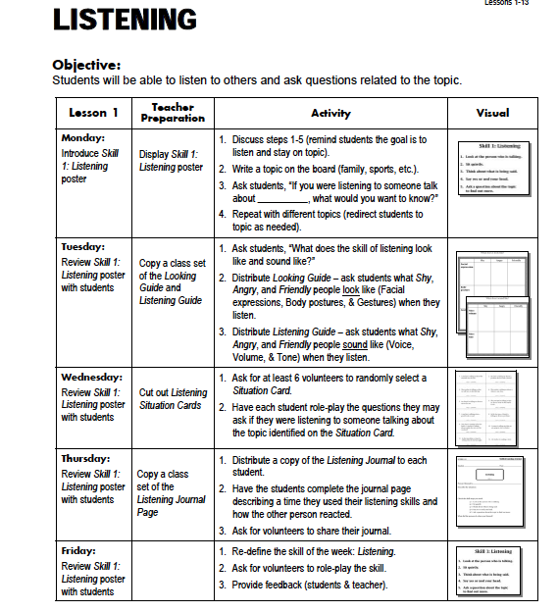
Skillstreaming

Slide 16
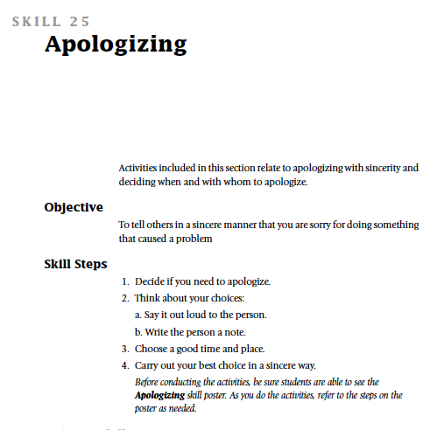

Slide 17
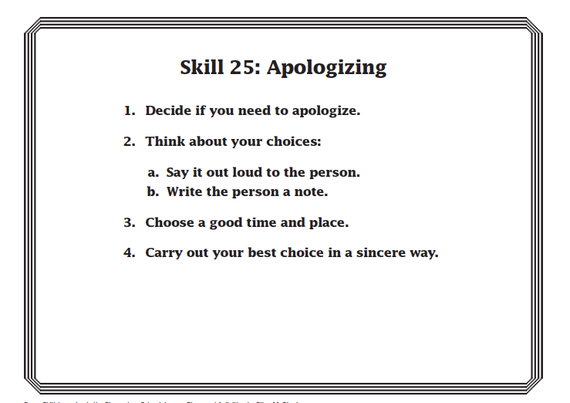

Slide 18
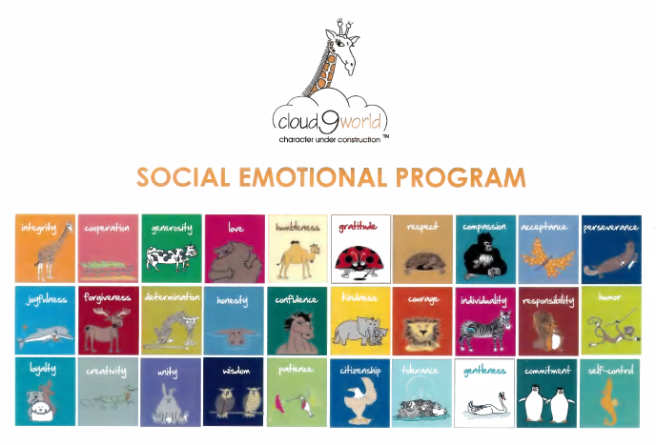

Slide 19
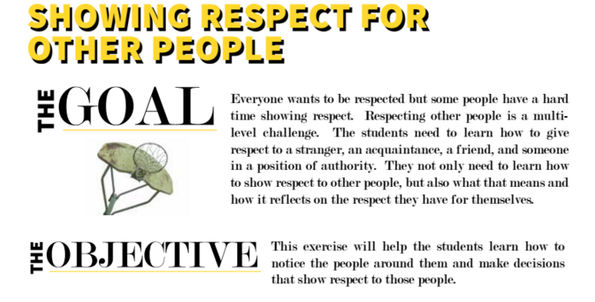
Go LEAPS
Notes:
Go LEAPS lesson example- teachers can choose all of the components or just a few. Whole group or small group.- it doesn’t have to take a lot of time

Slide 20
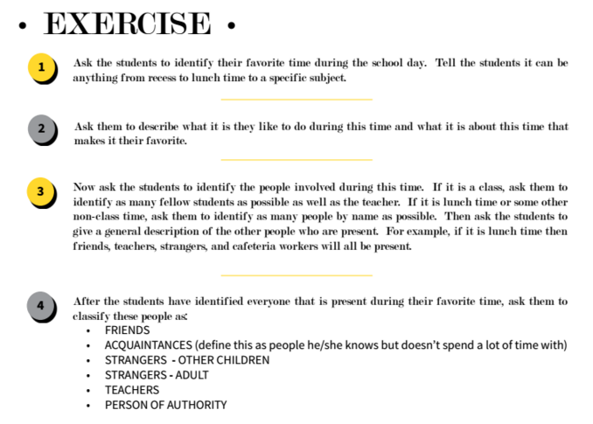

Slide 21
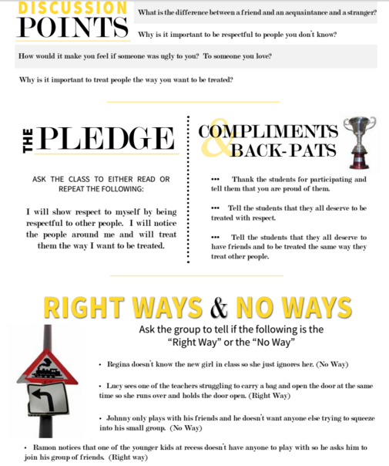

Slide 22
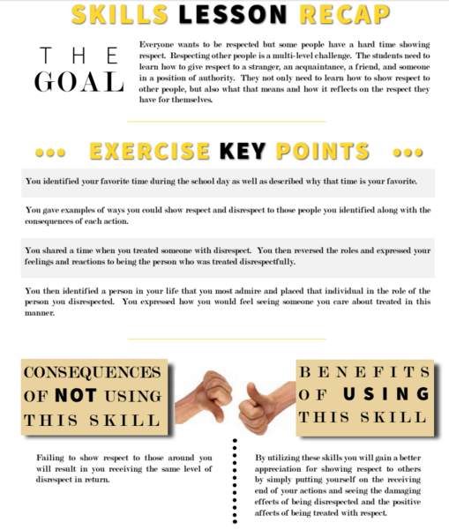

Slide 23




Slide 24
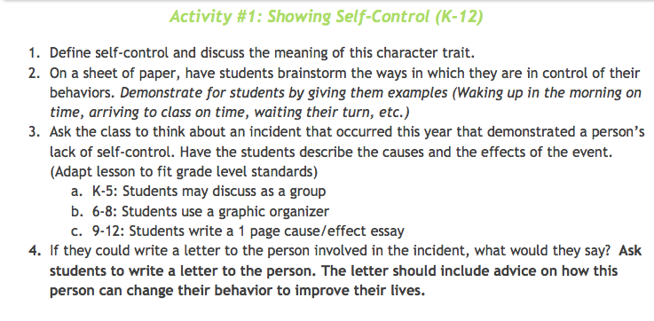
Sample Character Ed Lesson

Slide 25
Teaching Behavior Lessons
Set the context - Explain why the lesson is important or relevant
Define concept or skill with examples & non-examples
Have students apply the knowledge or skill
Provide additional practice with feedback
Differentiate instruction based on student need
Expectations
Concept-Level Lessons
Rules
Students must rehearse specific skills in the identified setting
Notes:
Now that you have created Expectations and Rules, they must be overtly taught to the students.
Teaching behavior lessons is very similar to teaching academics. I may sound like a broken record here, but I want you to come away with the understanding that teaching behavior should be taught.
Lesson plans for expectations & rules basically look the same **except that lesson plans for rules need to start with the expectation***and they need to incorporate practice of positive behavioral skills. Rule lessons need to occur in the setting where they apply. Many schools use a station rotation format for classes to visit the targeted areas, such as the cafeteria or media center, to learn the setting-specific rules.

Slide 26
What Should it Look Like?
Provide rationale including when it will be useful
Task analyze the skills in the step
  Model
  Practice (examples & non-examples) along with feedback and until mastery
Provide a cue to use when prompting student use in future
Provide examples of when to use skill outside classroom
Schedule ongoing practice of skill in real-life situations
Provide information for parents and activities for at-home with the skill
Notes:
Things that you should know when you are teaching behavior. When will it be useful? Why are we doing this? Often we talk about making academics relatable to real life and we need to do the same with behavior. Relatable to school and home as well. Make sure we model what those skills look like. Rule: raise your hand in classroom. just because I taught when and how doesn’t mean that they knew not to call out and start talking. I had to task analyze as soon as hand went in air he was talking. Need to teach to wait to be called on ,etc. Examples and non examples. Link at bottom is from edweek on SEL and why we should teach it.

Slide 27
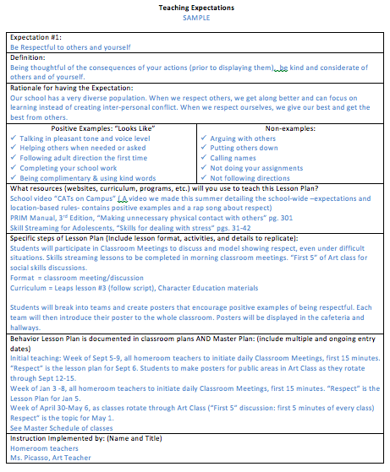
Sample Lesson Plan: Expectations
Notes:
This is a sample Lesson Plan for teaching expectations. Lesson Plans are for small-group and classroom lessons. Behavior needs to be taught in the same format as any academics. We do not hold “academic assemblies” at the beginning of the year to teach algebra and should not hold “behavior assemblies” to teach behavior unless they are supplemented with these teacher-directed lesson plans.
This lesson plan is for expectations, refer to the go leaps lesson plan example. The examples and non-examples are important to include when teaching expectations because student may not know what being responsible or respectful is or what it means. The examples and non examples provide a description of the behavior so students can see what it looks like to behave that way.
There is a completed sample plan in the Attachment Tab; Your team can print it out to help develop your own school-wide lesson plans. Each lesson plan should have different resources, format and activities, just as we vary the academic lesson plans for students.

Slide 28
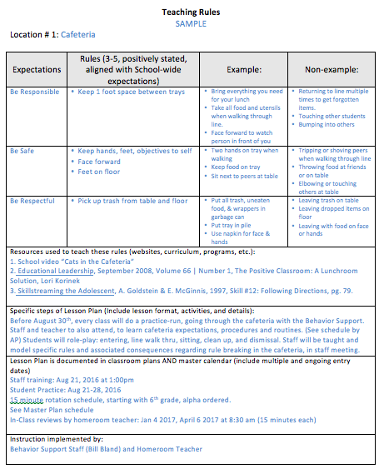
Sample Lesson Plan: Rules
Notes:
This is a sample Lesson Plan for teaching Rules in the cafeteria. It is also in the attachments tab. Complete your lesson plans in specific detail so that they will be able to be replicated by every teacher. You will have 3 Rules Lesson Plans – one for each of your Top 3 Locations.
Create 1 Lesson Plan for EACH Top 3 school locations
To be taught in a CLASSROOM, by a teacher
(not just in a behavior assembly)
small group learning and activities that include:
operationalizing expectation into positive behaviors
practice of the appropriate behaviors
To be taught throughout the year
(when students breaking rules and after long breaks)
Detailed with enough specifics to be replicated by others

Slide 29
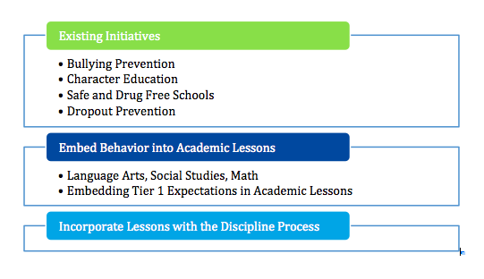
Behavior Curriculum Development
Notes:
Another rebuttal to the “I don’t have time to teach behavior” argument: the behavioral curriculum should be embedded in ongoing school activities/initiatives, academics, & discipline process.
Existing initiatives: These initiatives should incorporate Tier 1 expectations
If teachers are embedding behavioral lessons into academic content areas, try to build a lesson plan bank so others can use the resource, and so teams can point to a behavioral curriculum (evaluation item on the Benchmarks of Quality). Schools and districts have used their internal/ shared drives for this.
Think of creative ways to teach the student code of conduct. Give students case scenarios and have them identify the possible consequences of these behaviors.

Slide 30
Implementing Lessons
Introductory Events
    High profile: School-wide assembly, station rotation
    Input from staff and families
On-Going Formal Lesson Plans
    Set a Schedule: Minimum requirements for number and frequency of lessons
    Use Your Data
      Last year’s data (historical trends)
      Current data
      Staff and family feedback (surveys, focus groups)
Notes:
Schools should not say they’ve embedded their lesson plans into their discipline process & use this as their only evidence that they’re teaching behavior. Administrators will need to identify some time in the master schedule for explicit instruction in the expectations & rules.
Schools can handle the introductory events fairly easily – they usually incorporate the roll-out with their beginning of year welcome-back assembly…
A set schedule is necessary to help develop a common language at the school – everyone hears the same info at the same time and to help the school accountable. Instruction should be data-based, so it’s responsive to current needs. Teams can look at historical trends to identify what skills are most needed at different times of the year, they can solicit faculty input as to what’s needed, and they can look through their ODRs for the current year to see what the most common problems are. Ie a school I support was looking at their trend data and noticed they typically see an increase in ODRs in February, to be proactive, they scheduled time for reteaching of behavior lesson plans in January and review at beginning to help reduce their referrals.

Slide 31
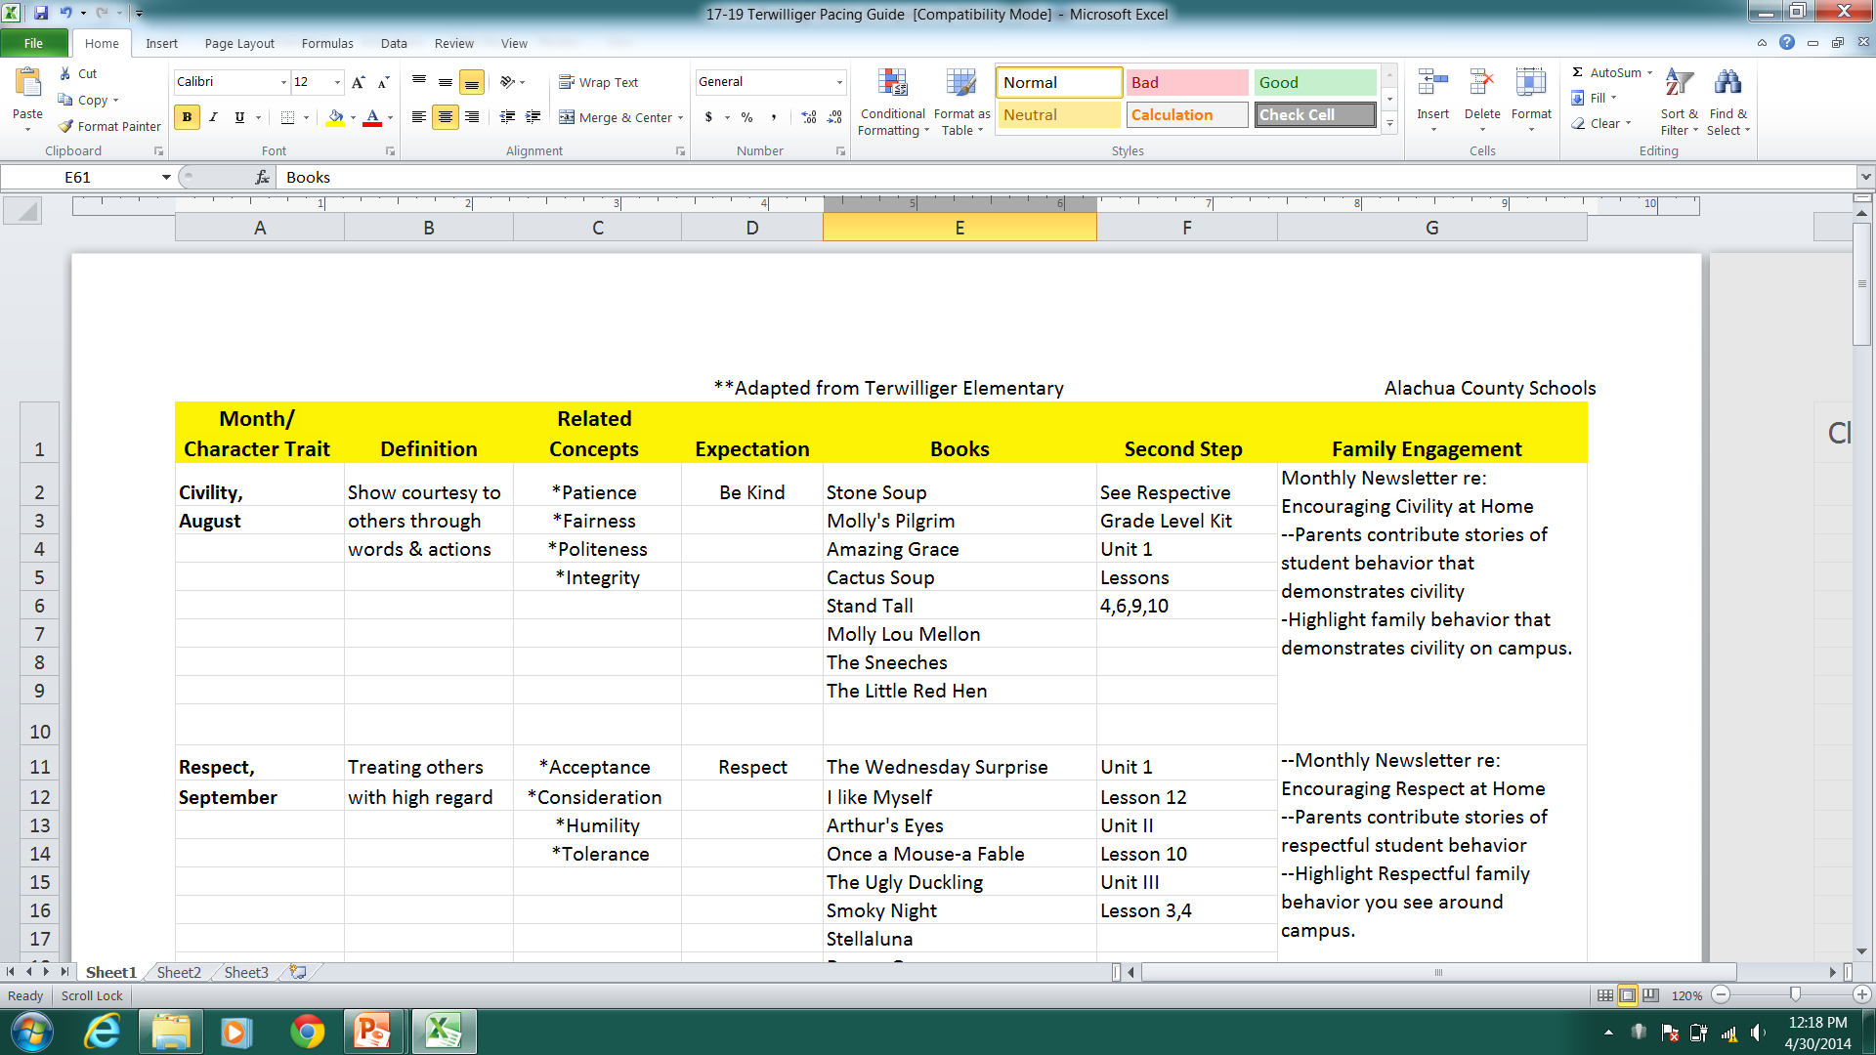
Behavior Curriculum Pacing Guide
Twillinger Elementary
Notes:
Animation starts automatically
Teams will need help reading this slide…just give them the gist & direct them to the misc section. Note that the original pacing guide was adapted by the PBIS Project by adding the Family Engagement column.

Slide 32
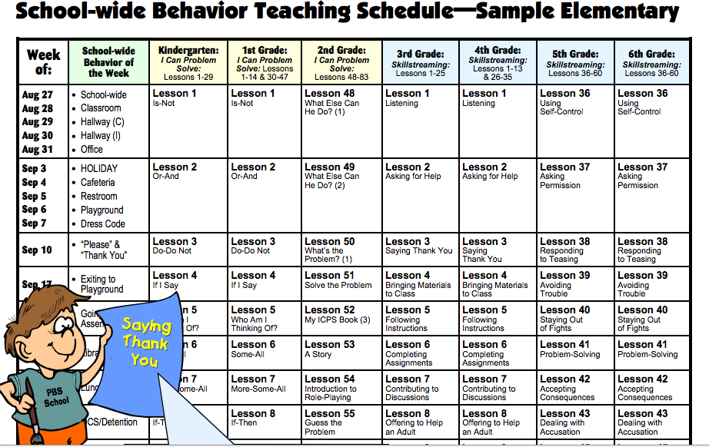
Notes:
This school chose to teach “behavior of the week” included “I can problem solve” and skill streaming- they took a resoure they already had at the school and then shared out with teachers. Also takes presssure off of teachers who say they don’t know how – you previded the lessons for them and they don’t have time- you put the times on the master schedule. Without a schedule, the lessons kind of go by the wayside and are not actually taught.

Slide 33
Scheduling Lessons
Videotape introductory events
Morning announcements
Homeroom/calendar time
‘Specials’ area teachers deliver lessons
Include a social skills class as an elective
Shave 1-2 minutes from each subject throughout day
Utilize community resources to support lessons
Link with family and community events
Notes:
These are all examples of how schools have made time for formal lessons on behavior. Don’t read every bullet – let teams know this info is here so they can reference it. Teams need to think outside of the box & examine their master schedule with an open mind to find ways of carving out time for these lessons.
Re: Videotaping Week 1 intro events…new students can watch the video to be oriented to the Tier 1 expectations; the video could also be looped in the front office for everyone to see/hear while they wait.

Slide 34
Informal Ways to Support Lessons
Posters or murals
T-Shirts
Agenda or book covers
School pledge/ song/ cheers
Expectations printed on school-wide tokens
Expectations on school marquee and/or hold message
Model the expected behavior
Reward appropriate behavior as it happens
Engage family and community to support lessons
Use technology
Notes:
The more they teach & use the language of their Tier 1 expectations, the more effective they’ll be in changing behavior. You might want to emphasize having posters around the school, since that’s an evaluation item on the Walkthrough. Also emphasize that these can serve as prompts for appropriate behavior, and will help remind teachers to stay focused on the positive.
Use technology (e.g., show Tier 1 expectations on screensavers)

Slide 35
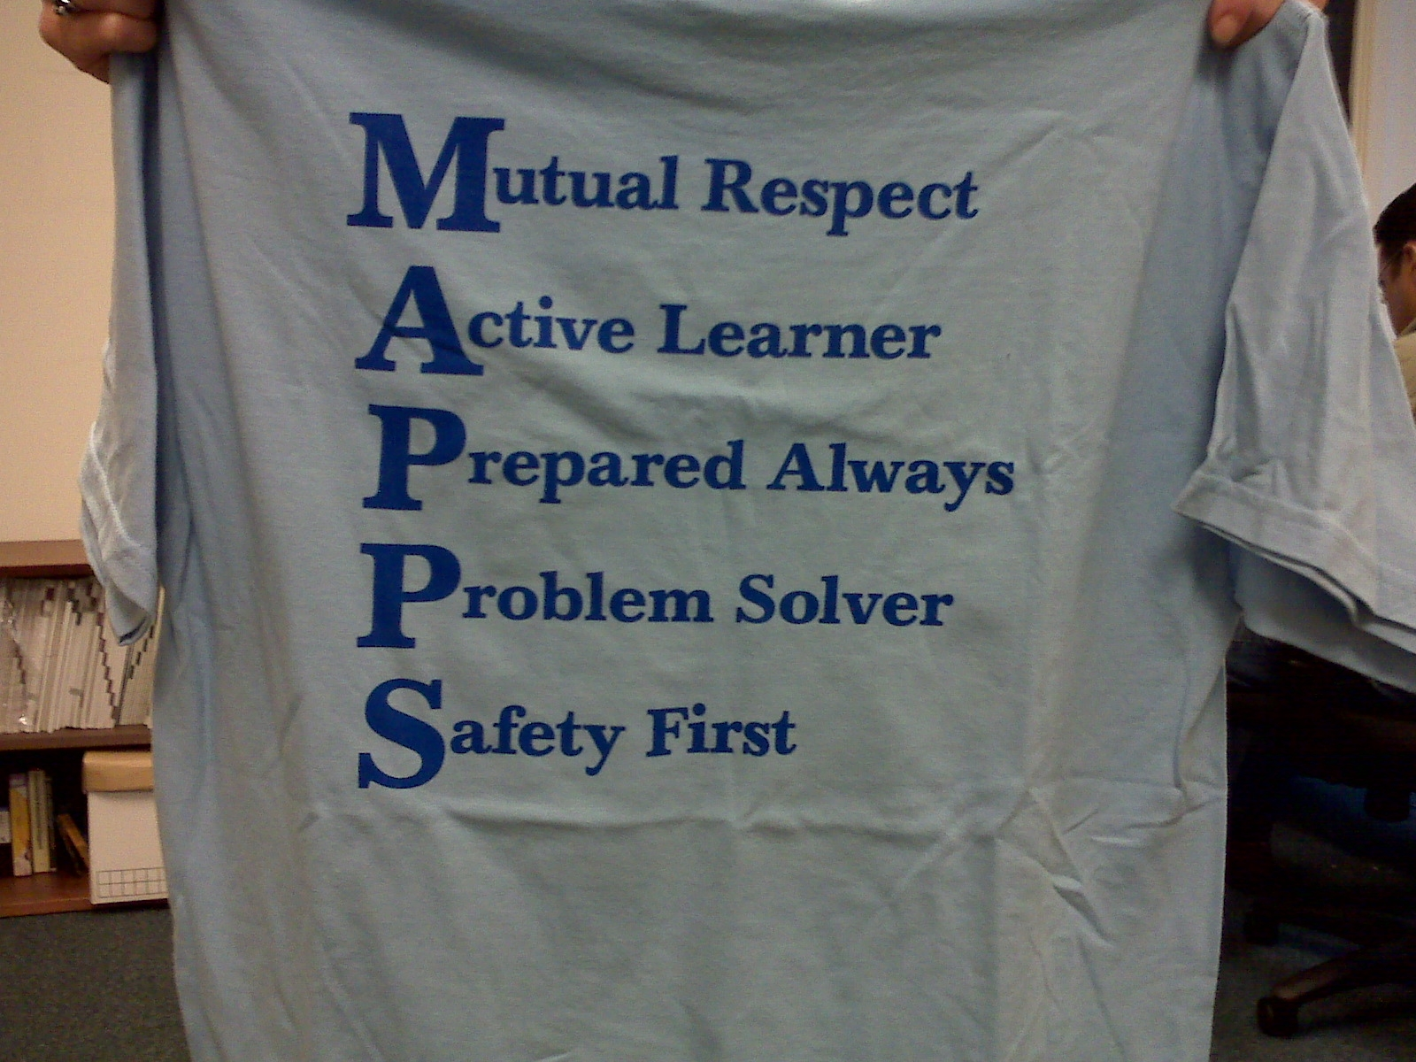
Notes:
Just an example. T-Shirts are popular, can serve double duty as incentives, dress code alternatives, etc…

Slide 36

Teaching Expectations and Rules
Notes:
CHAMPs video – Elementary. This video shows how an elementary school introduced CHAMPs voice levels to their students. ** this is tier 1. Use in media, hallway, etc.

Slide 37
Monitoring Fidelity
Lesson Times on Master Schedule
    Behavior curriculum is a priority
    Administrator walkthroughs
Permanent Product Samples
    Posters, pictures
    Essays, etc.
Classroom Monitoring of Lessons Plans
    Example: Students create a checklist for “Being Prepared” for class. Students fill out their checklists daily to assess their behavior, and graph the results on a wall chart.
Interview sample of students, staff and families
Notes:
Reminder to schools that everyone is responsible for implementing the core (teaching), it’s not optional. It’s the administrators’ responsibility to communicate that this is just as important as academic instruction..
Related to this idea, putting behavioral lesson times on the master schedule can help administrators ID which times to conduct walkthroughs if they want to see how the curriculum is being taught. This also helps the staff by allocating time to do what they’re being asked to do.
Interviewing random staff/students…if they can’t name the expectations, they probably weren’t taught (or they weren’t taught very well/often enough).
Interview random sample of parents as well- drop off/pick up; phone calls; post questions online, email messages, blogs, school Facebook page-
37

Slide 39
Summary
Behavior instruction must be systematic & ongoing
Use what is already in place, if it works, but incorporate Tier 1 language
Use formal & informal instructional methods
Make lessons easy for staff to deliver
Develop a system to ensure fidelity
Involve students, families, and community in lesson plan development and implementation
Notes:
Use this slide as a wrap up. Just remind them that it is as important to teach behavior like we teach academics.
Family Engagement:
Record everything you do and share with families (remember to have consent for those in the videos)- make it available on their parent portal for them to watch when convenient
Open up media center for parents to use computers when necessary.
Sharing videos with parents- showing them what each expectation looks like and what the rules look like in every setting

Slide 40
Upcoming Webinars
Date | Webinar Topic
Thursday- April 28, 2016 | Implementation Plan
Thursday- May 25, 2016 | Classroom PBIS Systems & Evaluations
Notes:
I thank you for your attention to this webinar. I trust that the information shared about the four step process and the application of BASIS dashboard to your work will keep you informed, current and ever vigilant in the work you are doing with your team and staff.
*** make a note about the May 25th webinar. It will focus on classroom pbis systems whereas today, we are looking at Lesson plans for Tier 1 schoolwide.

Slide 41


Contact Information
Diversity, Prevention & Intervention
Lauderdale Manors Resource Center
754-321-1655
or visit our website at:
www.browardprevention.org
Notes:
You can contact us at the number listed above if you have additional comments and questions regarding today’s webinar.
Please continue to use our website. It provides a wealth of resources. If you have questions about the website and the resources there, please contact us.

