Slide 1


Data-based Problem Solving in a
RtI:B Team Meeting
3.0

Slide 2
Who?
A team with mandatory members (Principal, BTU Rep, RtI:B Leader,
and Community Representation. Additional members must establish
representation of all other stakeholders.
support team
students
paraprofessionals
specific grade levels
specials teachers
families
community

Slide 3
When?
It is recommended that the RtI:B team meet regularly to be able
to adjust implementation of the School-wide Behavior Plan quickly
in response to student needs. Teams must maintain sign-in and
minutes of these meetings.
Minimum = Quarterly meetings
Recommended = Monthly meetings

Slide 4
What?
It is the team’s responsibility to use the 4 Step Problem Solving Process
to review current school-wide behavioral data, to create
research-based interventions to address the school’s most prominent
behavioral needs, and to teach and document these for all stakeholders.
Problem Identification
Problem Analysis
Intervention Design
Progress Monitoring

Slide 5
Why?
A flexible and responsive Tier 1 School-wide behavior curriculum
provides preventative interventions and effective behavioral strategies.
create consistency with behavior language, behavior expectations,
positive reinforcement, and response to inappropriate behaviors
reduces frequent misbehaviors on the campus
increases the likelihood of appropriate behaviors
reinforces and supports staff in implementation
improves positive school climate and culture

Slide 6
Necessary Data To Make Decisions At Each Tier
Tier 1: Universal | Tier 2: Targeted | Tier 3: Intensive
Big 5 | Big 5 | Big 5
Out of school Suspensions (OSS) | Out of school Suspensions (OSS) | Out of school Suspensions (OSS)
In school Suspensions (ISS) | In school Suspensions (ISS) | In school Suspensions (ISS)
Requests for assistance | Requests for assistance | Requests for assistance
Faculty, student, family surveys | Classroom observations | Student observation
School Climate Surveys | Daily progress reports | Behavior rating scales
 | Standardized screening tools | FBA forms and processes
 |  | Individualized measures of student outcomes

Slide 7
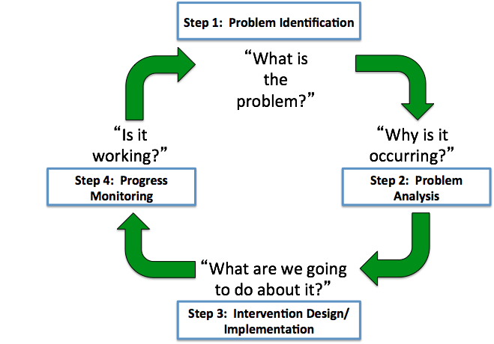
Using the 4 Step Problem Solving Process to support behavior
The “Big 5”
1. Core Effectiveness/Student
2. Referrals by Behavior
3. Referrals by Time:
of Day
of year (monthly)
4. Referrals by Location
5. Referrals by Teacher and/or
grade level
6. Referrals by Admin. Action
7. Referrals by Disproportionality
BASIS

Slide 8
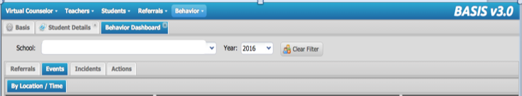
How to “read” the Behavior Dashboard in BASIS 3.0
Referral: ODR for individual student –such as "John punched Henri”
Event: an occurrence that may contain multiple referrals and incidents - such as "Fight”
Incident: the District’s behavior codes related to the referral. There can be multiple incidents - such as ‘Battery’ and ”Destruction of Property" during the fight (Event)
Action: the consequence imposed by Admin - such as "phone call home" or "no action". Actions are imposed based on the most severe incident of the event.

Slide 9
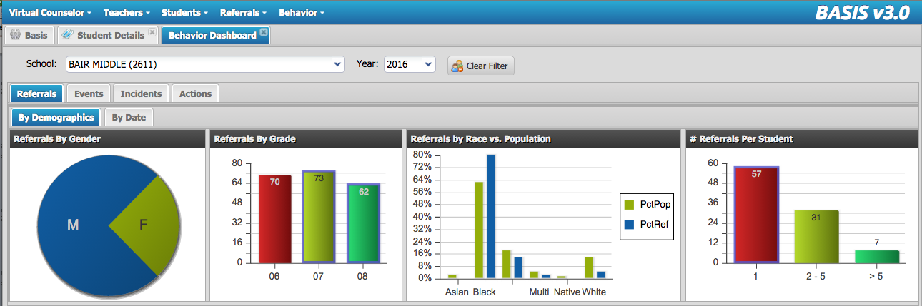
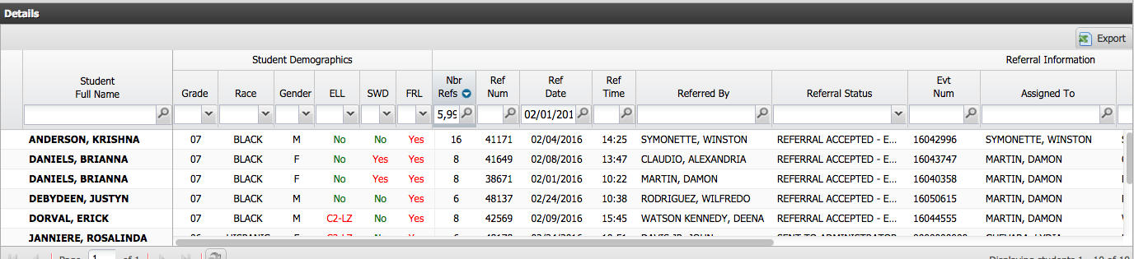
1. Core Effectiveness (Referrals by Student)
57
31
7
16
Notes:
Filter by 5+ in “Number Referrals”.
Sort descending to get names of top offenders.

Slide 10
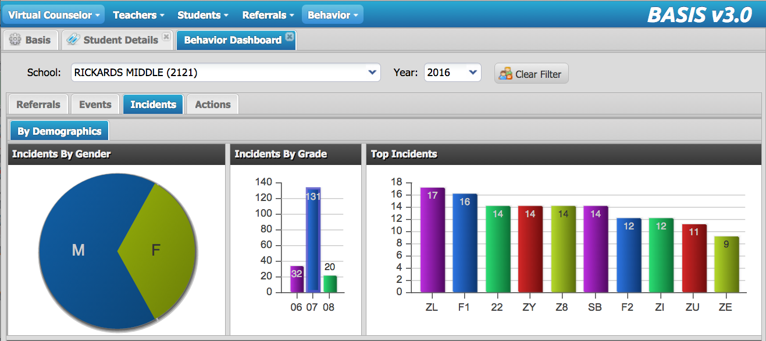
2. Referrals by Incident (Behavior Type)
Skipping
Fighting, Battery
Does skipping lead to confrontations and conflicts?
Why are students being aggressive and handling interactions physically?

Slide 11
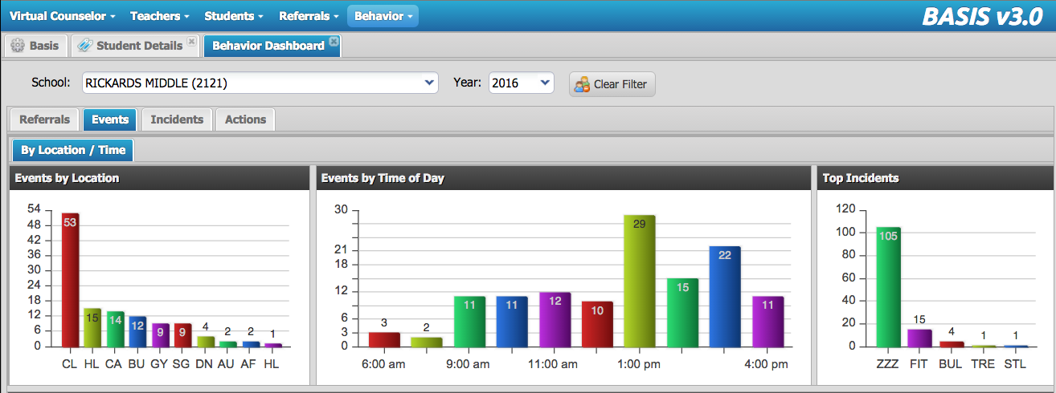
3a. Referrals by Time of Day
Lunch
Peak at lunch. How to reduce?
Peak in afternoon: 100% higher than morning referrals. Why?

Slide 12
3b. Referrals by Time of Year (monthly)
November: 6 to 11 = 83% increase in referrals. Why?
January: 20 to 10 = 100% decrease in referrals. Why?

Slide 13
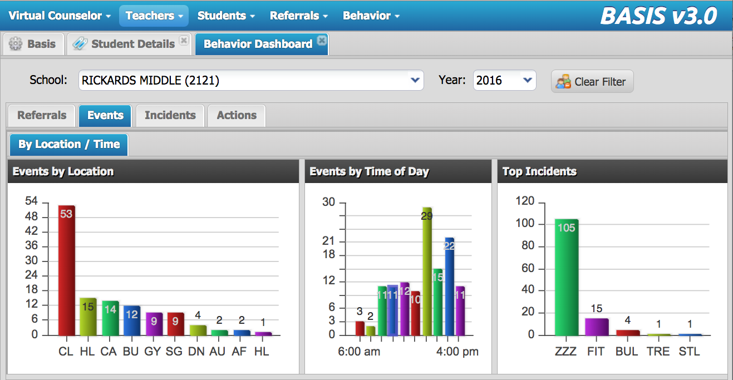
4. Referrals (Events) by Location
Notes:
Referral: ODR for individual student -such as "John was fighting"
Event: an occurrence that may contain multiple referrals and incidents - such as "Fighting"
Incident: the coded behavior that is connected to referrals. There can be multiple incidents - such as ‘fighting’ and "destruction of property" during the fight
Action: the consequence imposed by Admin - such as "phone call home" or "no action". Actions are imposed based on the most severe incident of the event.

Slide 14
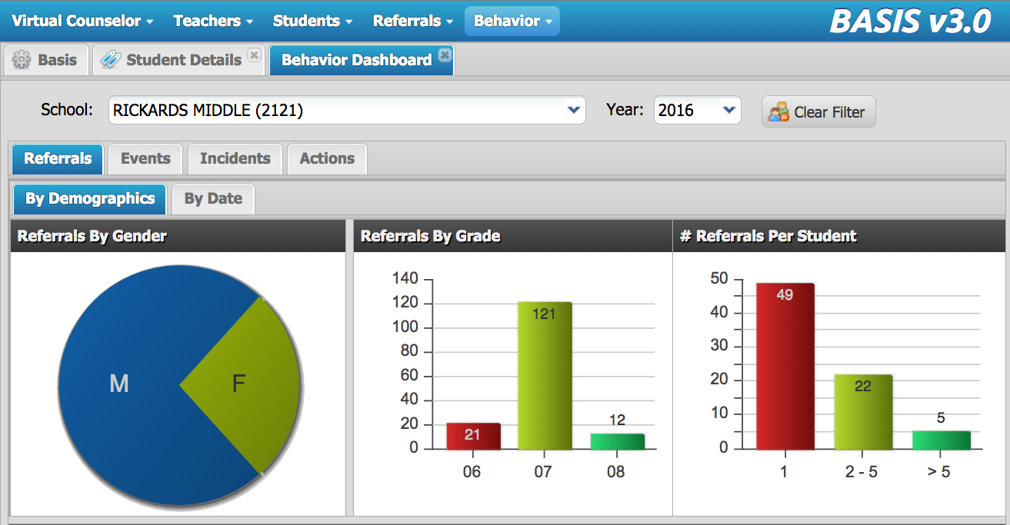
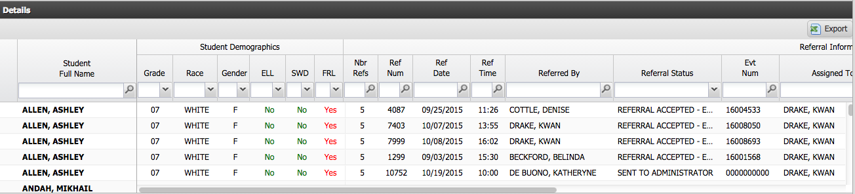
5. Referrals by Teacher (and grade level)
C
Teacher A = 47

Slide 15
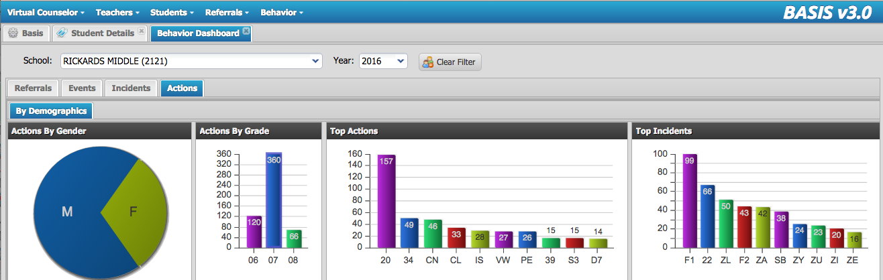
6. Referrals by Action
20 = Parent Conference
360 referrals x 15 minutes each = 5,700 minutes = 95 hours = 15.8 days = 3 weeks...
...by November!!

Slide 16
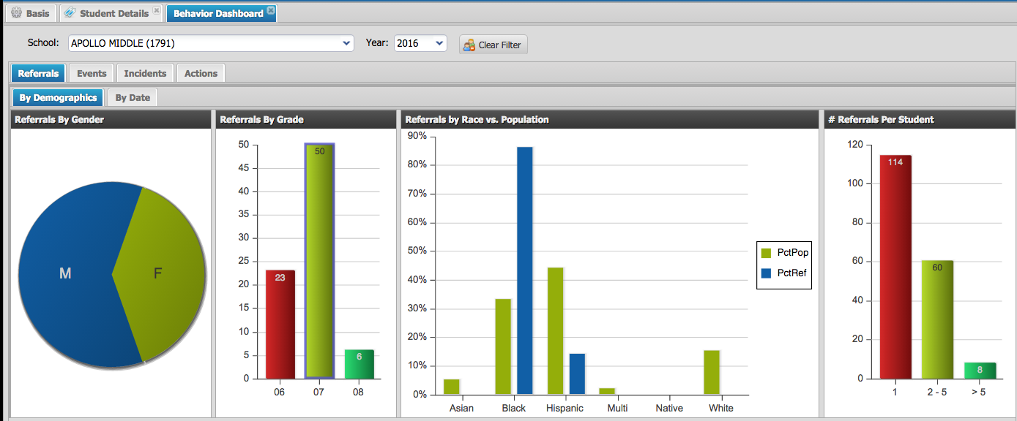
7. Referrals by Disproportionality
33% of the population are Black, but they are receiving 80% of the referrals

Slide 17
So what Problems did we Identify?
Core effectiveness seems good. 7 students with > 5 referrals.
1 student with 16 referrals by November.
2. Referrals in Grade 7 are 4 X the number of referrals in any other grade
121 referrals in Grade 7
3. Teacher A = 47 referrals (39% of referrals)
4. Referrals double in the afternoon
5. Top incidents = Skipping (pivot behavior?) 17
Fighting and Battery 16+14 =30
6. Admin has spent 95 hours disciplining students and
making negative phone calls home, NOT developing relationships or
focusing on learning
7. 33% of the population (Black students) receiving 83% of the referrals

Slide 18
Problem Identification:
Individual teacher support issues:
Teacher A = 47 referrals
Progress Monitoring:
decrease in ODRs
increase in appropriate behavior
durability of behavior change
generalization of behavior change
increase in academic achievement
AND
Direct observations (7 Up)
Review of teacher behavior lesson plans
Problem analysis:
direct observation: frequency,
duration, scatterplot, A-B-C
data collection:
  7 UP
  Classroom Assessment Tool
Consultation with teacher
37
Intervention Design:
7 components of CHAMPs
embed teaching behavior
school-wide behavior lesson plans
classroom interventions

Slide 19
Resources
browardprevention.org ➔ RtI Tab ➔ RtI:B Tab ➔ Tier 1 Resources
➔ Data Entry & Analysis
Contains:
Data Collection template
Meeting Agenda template
Data Analysis Action Plan
7 Up
CAT
Also, state-level
resources available at:
flpbs.fmhi.usf.edu

Slide 20



Contact Information
Diversity, Prevention & Intervention
Lauderdale Manors Resource Center
754-321-1655
or visit our website at:
www.browardprevention.org
@ Broward, Prevention & Intervention
@ DiversityBCPS
Notes:
If you have any questions or need any further information about the 4 Step Problem solving process, please contact our office at 754-321-1655 or visit our website.

